Slide 1
Prognosis
The temporal dimension of diagnosis
Gennaro D’Amico
Gastroenterology Unit
V Cervello Hospital – Palermo
gedamico@libero.it

Slide 2
Prognosis and prognosis research
Prognosis refers to the probability of an individual patient developing a particular outcome over time, based on his clinical and non-clinical characteristics and on their combination with disease specific characteristics
Prognosis research investigates the relationship between candidate predictors and outcome

Slide 3
The link between diagnosis and prognosis
Prognosis research

Slide 4
The link between diagnosis and prognosis
Patients mainly benefit from medical testing if it affects future medical decisions
This implies that diagnostic tests are clinically relevant if they not only inform on the disease status but also on the future outcome
Hence the relevance of diagnostic information is closely related to prognosis: the implication for the future course of the patient’s condition

Slide 5
The temporal dimension of the diagnosis of cirrhosis
Ratib S J Hepatol 2014;60:282-289
Diagnosis of
cirrhosis
Future implication of diagnosing cirrhosis

Slide 6
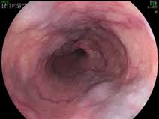
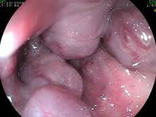
The temporal dimension of diagnosis
Esophageal varices in cirrhosis
1.00
No varices
0.75
Small varices
0.50
Large varices
0.25
% free of bleeding
0.00
0
50
100
Dig Dis Sci 1986; 31: 468-75; APT 2014;39:1180–1193

Slide 7
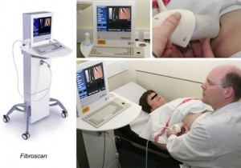
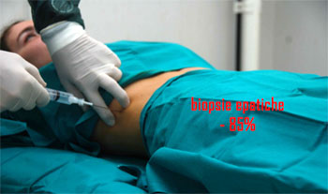
LSM accuracy for liver cirrhosis has been verified using liver biopsy (LB) as a reference standard (RS)

Slide 8
LSM for alcoholic cirrosis
summary performance for cut-off=12.5 KPa
sens .95(.87-.98); spe .71(.56-.82); LR+ 3.3(2-5); LR- 0.07(0.03-0.19)
Pavlov C Aliment Pharmacol Ther 2016; 43: 575–585

Slide 9
Imperfect RS
Interpreting disagreement between IT and RS
 | Liver biopsy (RS)
 |  | Cirrhosis | Non cirrhosis | total
 | Positive | 157 | 42 | 199
 | Negative | 10 | 121 | 131
 | total | 167 | 163 | 330
cases
detected only
by LSM
LS more
sensitive?
LS ≥ 12.5 KPa
cases
detected only
by LB
LS more
specific?
Data from: Pavlov C Aliment Pharmacol Ther 2016; 43: 575–585

Slide 10
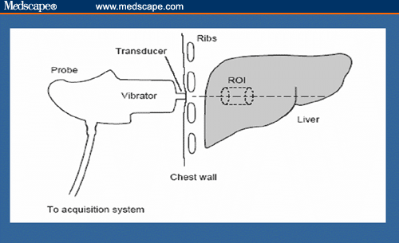
Interpreting disagreement between LSM and LB
Cases detected only by LB
Do this patient have cirrhosis
LB
LSM
LS <12.5 KPa
definitely yes
False Negative

Slide 11
Interpreting disagreement between LSM and LB
Cases detected only by LSM
Do this patient have cirrhosis
LB
LSM
LS ≥12.5 KPa
May be
false negative
LR+ 3.3
Post Test P > .90
If pre test P > .60

Slide 12
Survival of patients with CLD according to LSM
LS > 12
Boursier J. Gastroenterology 2016
Sultanik P. APT 2016

Slide 13






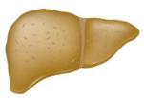
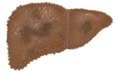
CHRONIC LIVER DISEASE
Redefining nosography
TRANSIENT
ELASTOGRAPHY
LIVER BIOPSY
Baveno VI
CLINICAL DIAGNOSIS
F0/1
F2
F3
ACLD-LC
Augustin S. Baveno VI proceedings. Springer 2016

Slide 14
The link between diagnosis and prognosis
Prognosis research

Slide 15
Prognosis research
  Prognosis
  Possible outcomes of a disease and the probability with which they can be expected to occur.
Predictive (or prognostic) factor
Factor, from history, physical examination or diagnostic tests, associated with the risk (probability), or with the rate (incidence), of an event
Predictive (or prognostic) models
Decision-making tools for clinicians, combining several predictive factors to predict the patient risk of an event

Slide 16
Example of prognostic indicators
Mortality%
2yr | 5yr
No Varices
8 | 20
No Ascites
17 | 39
Varices
Cirrhosis
No Varices
36 | 73
Ascites
54 | 68
Varices

Slide 17
Multiple prognostic indicators of death in cirrhosis Esophageal Varices and Ascites
1.00
No varices, no ascites
n=490
0.75
0.50
ascites, no varices
n=141
Proportion surviving
Varices, no ascites
n=282
ascites, and varices
n=208
0.25
Log-rank test
chi2(3) = 265.83
Pr>chi2 = 0.0000
0.00
0
24
48
72
96
120
months
Cumalative data from Dig Dis Sci 1986; 31: 468-75; Gastroenterology 2001; 120: A2

Slide 18
Prognostic index (or prognostic model)
A prognostic index is derived by an appropriate multiple regression analyses
In the general format, each signifcant variable is multiplied by a coefficient provided by the statistical analysis

Slide 19
How does it work
Simulation of a prognostic index for mortality in cirrhosis
Cox model multivariable analysis
Variable | rating | Coefficient | p
Ascites | No=0 Yes=1 | 1.36 | 0.000
Varices | No=0 Yes=1 | 0.36 | 0.000
Prognostic index (PI) in the individual patient
PI = (Ascites * 1.36) + (Varices* 0.36)

Slide 20
Methods The development cohort consisted of 3584 patients without cirrhosis from the community- based Taiwanese REVEAL-HBV study (of whom 131 developed HCC during follow-up), ………..
We used Cox multivariate proportional hazards model to predict risk of HCC at 3, 5, and 10 years. Variables included in the risk score were sex, age, serum alanine aminotransferase concentration, HBeAg status, and serum HBV DNA level. …………..

Slide 22
Validation
Validation is required because:
A model’s performance is likely to be overestimated when it is developed and assessed in the same dataset. The problem is greatest with small sample sizes, many candidate predictors and weakly influential predictors
The association between prognostic indicators and the outcome may be casual
May be specific for the particular conditions realized in a given study
The prognostic model may be difficult to apply in clinical practice
Validation prompts physician to trust probabilities provided by the predictive model
Mc Ginn TG, JAMA 2000;284:79-84
Moons KGM BMJ 2009;338:b375

Slide 23
Methods The development cohort consisted of 3584 patients without cirrhosis from the community- based Taiwanese REVEAL-HBV study (of whom 131 developed HCC during follow-up), and a validation cohort of 1505 patients from three hospitals in Hong Kong and South Korea (of whom 111 developed HCC during follow-up).
We used Cox multivariate proportional hazards model to predict risk of HCC at 3, 5, and 10 years. Variables included in the risk score were sex, age, serum alanine aminotransferase concentration, HBeAg status, and serum HBV DNA level. We calculated the area under receiver operating curve (AUROC) and calibration of predicted and observed HCC risk.

Slide 24
Discrimination
Calibration
Discrimination is the ability of a prediction tool to predict:
a higher probability of the outcome for those patients who will ultimately suffer the outcome; and
a lower probability of the outcome for those patients who will not.
Calibration is the ability of a prognostic model to predict event rates on a new series of patients
It is measured by comparing the observed and predicted event rates or risks

Slide 25
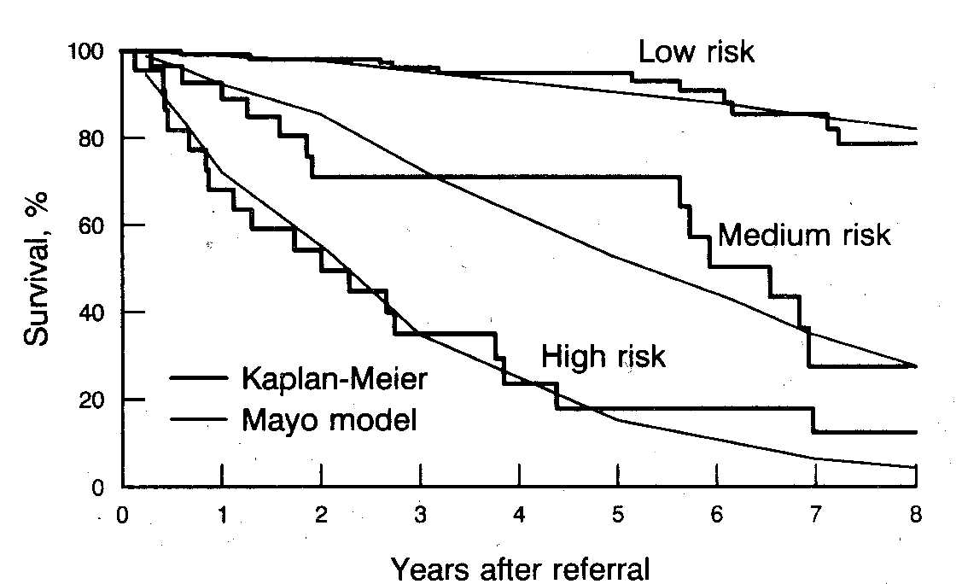
Calibration
Observed and predicted survival in PBC
Grambsch PM & al. Hepatology 1989; 10:846-850
log_{e} (bilirubin[mg/dL]) + (-2.53 x log_{e} albumin g/dl) + ( 0.039 x age, yrs) + (2.38 log_{e} x prothrombin time, sec) + 0.859 (edema) +0.871

Slide 26
The Ottawa ankle rule
Stiell IG. Br Med J 1995;311:594-597

Slide 27
Impact
The Ottawa ankle rule
Predictive rule: the derivation study showed sensitivity 100% and specificity 40%
In a validation RCT of 12770 patients (sensitivity 99.4%) a 26% reduction of radiological examinations was obtained
A subsequent cost-effectiveness study showed an economy of 3.145.000 $US per 100000 pts
Stiell IG. Br Med J 1995;311:594-597; Anis AH. Ann Emerg Med 1995;26:422-428
; Perry JJ. Int J Care Inj 2006;37:1157-1165

Slide 28


How can I apply the results from prognostic studies to my single patient?
Derivation sample
Application to single patients
Generalizability ?

Slide 29
Appraising prognostic studies for use in individual patient
Is the prediction tool
applicable to
Individual patients?
Are the results valid?
How does it work?
Discrimi-
nation
Calibra-
tion
Internal
Validity
Use in individual patients

Slide 30
Internal validity: Domains of potential biases
The Quality In Prognosis Studies (QUIPS) TOOL
Domain | Objective | Indicators of bias
1. Study participation | The study sample represents the population of interest | Key characteristics not reported
2. Study attrition | Loss to follow-up independent of key characteristics | Incomplete follow-up
3. Prognostic factors | Adequate measurement | Definition and measurement not adequately reported
4. Outcome
5. Confounding | Potential confounders appropriately accounted for
6. Analysis | Appropriate for the study design | Description of method and presentation of data
Hayden JA Ann Int Med 2013;158:280-286

Slide 31
Can I use the prediction tool in my patient care?
Item | Assessment
Generalizability External validation | Reproducibility: validation of the results in patients from the identical population
 | Transportability: validation in patients from different but related population
Importance | Broad impact analysis of the prediction rule as a decision rule
My patient’s characteristics | Are my patient’s characteristics and management similar to those of patients in the validation studies?
Follow-up and outcome | Was the follow-up long enough as to assess the outcome of interest in my patient?

Slide 32
Can I use the results in the management of my patient?
  Does the expected probability of outcome cross a decision threshold?
0%
threshold
threshold
100%
Reassure
Observe
Intervene
JAMAevidence 2011

Slide 33
Suggested phases of prognosis research
Research phase | Objective
Phase I | Assess/define candidate prognostic indicators and their range in healthy people
Phase IIa | Assess the natural history of the disease and incremental outcome risk compared to healthy people (cohort study)
Phase IIb | Detect prognostic indicators and build up a predictive rule (cohort study)
Phase IIc | Feasibility RCTs to test predictive strategies
Phase III | RCTs of the clinical impact of the predictive rule
Phase IV | Observational studies to assess applicability of the predictive rule on large scale and adverse events Further RCTs validating or recalibrating the original rule

Slide 34

Key concepts
Diagnostic tests bear prognostic information
Prognostic models allow to predict outcome risks or rates in patient-subgroups
A prediction tool must be valid, reproducible and generalizable, to be applied
To apply a prediction tool in individual patients, the patient characteristics must be similar to those of patient samples generating and validating the prediction tool
Application of the prediction tool is
expected to provide benefit
to the patient

