Slide 1


Diagnostic test accuracy.
Study design and the 2x2 table
DIAGNOSIS: the pathway of a diagnostic test from bench to bedside. Basic residential course.
Outline
Giovanni Casazza
April, 4 - 8, 2017 - Palazzo Feltrinelli - Gargnano, Lago di Garda, Italy

Slide 2
Outline
Design of a diagnostic test accuracy study
Summary of the results: the 2x2 table
Interpretation of the results: true and false results

Slide 3
Terminology
Index test (test under evaluation)
Reference standard (previously “gold standard”)
Target condition (disease of interest)
Key points of the diagnostic accuracy assessment procedure:
  Study design: setting and patients selection modality (consecutive? inappropriate exclusions?)
  Technical characteristics of the two tests
  Blinding
  Same reference standard for all the participants
  Threshold (predefined?)
  Time interval between index and reference (appropriate?)
  Statistical analysis (appropriate? participants excluded from the analysis?)

Slide 4
Study design
The aim of a diagnostic accuracy study is to evaluate the association between the index test results and the disease status of the study participants.
+
Index
Test
_

Slide 5
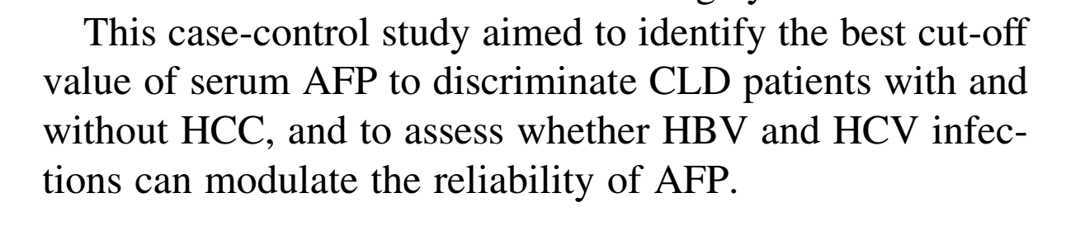
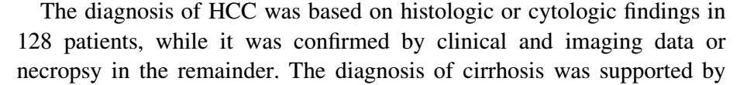
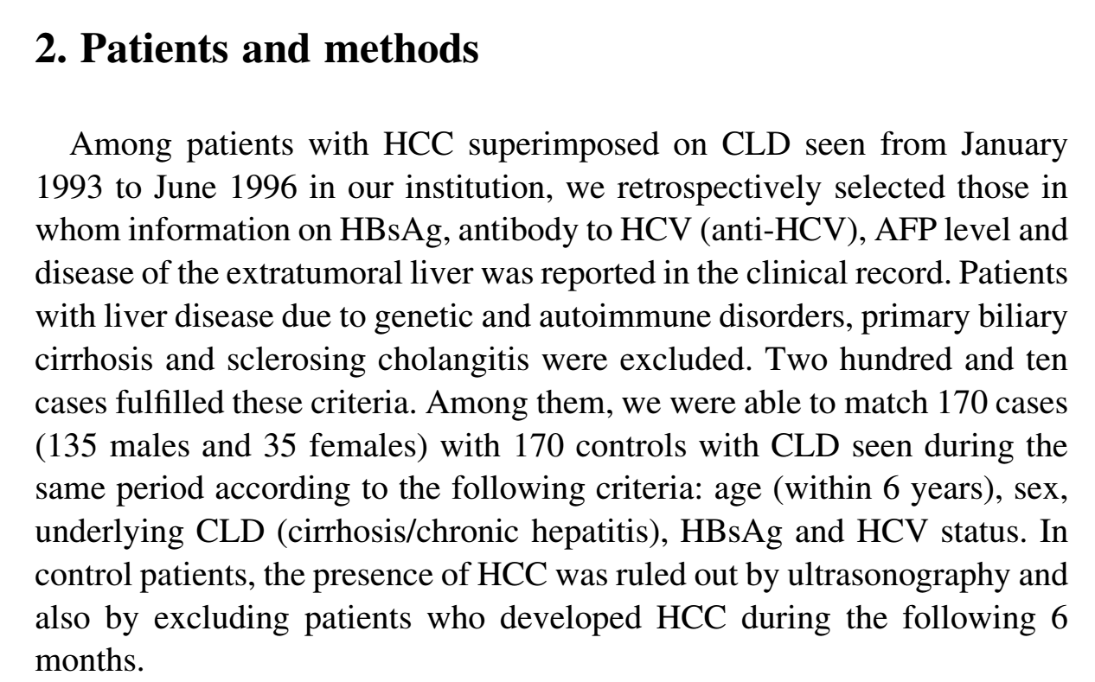

Study design
Study design: case-control
Index test: AFP
Target condition: HCC
Reference standard
Two samples
No HCC
(controls)
HCC
(cases)

Slide 6
Study design
Index test: Platelet count
Target condition: Esophageal varices
Reference standard: Upper gastrointestinal endoscopy
Participants included: only people with Child-A HCV Cirrhosis

Slide 7
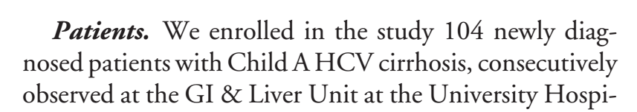
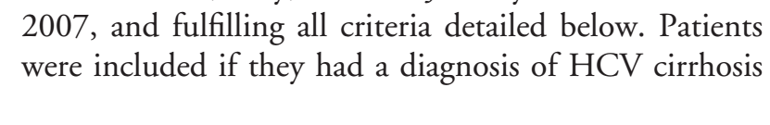
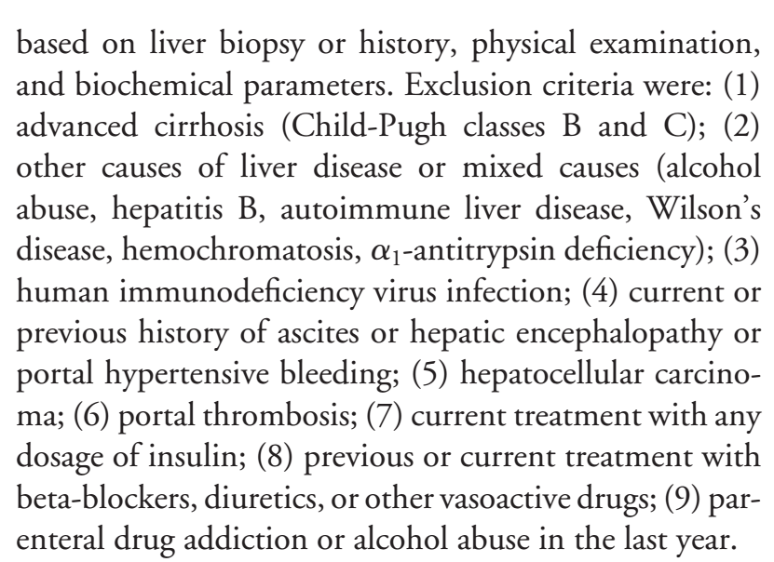
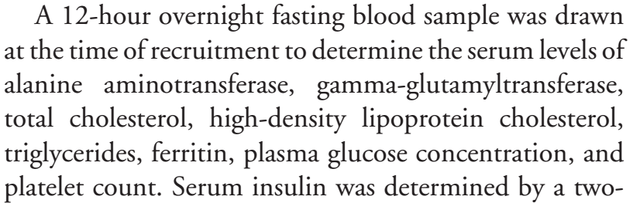
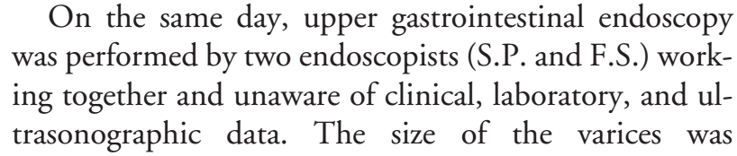
Study design
Patients selection
Index test: Platelet count
Target condition: Esophageal varices
Reference standard: Endoscopy
Inclusion/exclusion criteria
Index test
Reference standard

Slide 8
Study design
Study design: cross-sectional with consecutive patients selection
The index test and the reference standard are perfomed at the same time.
Index test: Platelet count
Target condition: Esophageal varices
Reference standard: Endoscopy
Diseased
+
+
-
Plt count
Endoscopy
+
-
+
Not diseased
One mixed sample
-
-
-
All patients suspected of having the target condition.
+

Slide 9
Diagnostic tests
When using a diagnostic test in clinical practice we would avoid errors (misclassification of patients).
A perfect index test.
All diseased individuals have a positive test result.
All non-diseased individuals have a negative test result.
Unfortunately this happens only in an ideal world. In the real world the result of an index test may sometimes be wrong.
We have to deal with false results.

Slide 10
Results of the study
Summary of the results of a diagnostic test accuracy study
The 2x2 table

Slide 11
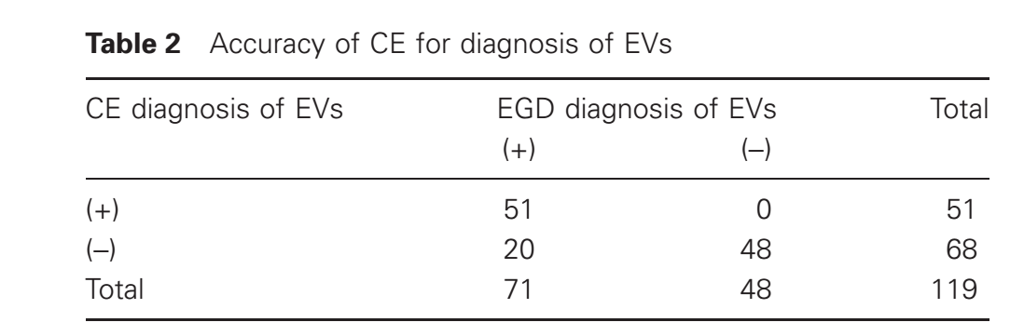
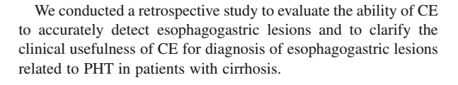
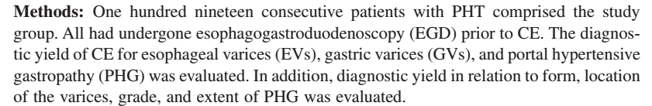
The 2x2 table
What is the 2x2 table?
It is a cross tab.
Built by crossing index test and reference standard results.
It is a summary description of the study participants.
Reference Standard
Index Test
Capsule endoscopy for the diagnosis of esophageal varices
Results:
  51 pts had a + IndexTest and a + ReferenceStandard
  20 pts had a – IndexTest and a + ReferenceStandard
  48 pts had a – IndexTest and a – ReferenceStandard
  0 pts had a + IndexTest and a – ReferenceStandard
Results:
  51 pts had a + IndexTest and a + ReferenceStandard
  20 pts had a – IndexTest and a + ReferenceStandard
  48 pts had a – IndexTest and a – ReferenceStandard
  0 pts had a + IndexTest and a – ReferenceStandard

Slide 12
The 2x2 table
What is the 2x2 table?
It is a cross tab.
Built by crossing index test and reference standard results.
It is a summary description of the study participants.
Reference Standard
Index Test
Capsule endoscopy for the diagnosis of esophageal varices
Results:
  51 pts had a + IndexTest and a + ReferenceStandard
  20 pts had a – IndexTest and a + ReferenceStandard
  48 pts had a – IndexTest and a – ReferenceStandard
  0 pts had a + IndexTest and a – ReferenceStandard
Results:
  51 pts had a + IndexTest and a + ReferenceStandard
  20 pts had a – IndexTest and a + ReferenceStandard
  48 pts had a – IndexTest and a – ReferenceStandard
  0 pts had a + IndexTest and a – ReferenceStandard

Slide 13
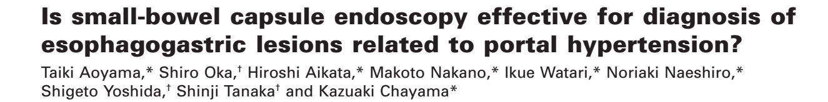
The 2x2 table
What is the 2x2 table?
It is a cross tab.
Built by crossing index test and reference standard results.
It is a summary description of the study participants.

Slide 14
The 2x2 table
What is the 2x2 table?
It is a cross tab containing four (2x2=4) numbers.
These four basic numbers carry all the information needed.
Reference Standard
Four cells
Two rows
Index Test
Two columns

Slide 15
The 2x2 table
TP
FP
Index Test
FN
TN
TP: True Positives
FP: False Positives
FN: False Negatives
TN: True Negatives
The 2x2 table contains all the information needed for a quantitative assessment of diagnostic accuracy.
Accuracy
how many times was the result of the index test “right”?
51+48=99
99/119=83%
Inaccuracy
how many times was the result of the index test “wrong”?
20+0=20
20/119=17%

Slide 16
Take home points
Optimal study design: cross-sectional with consecutive patients selection
The 2x2 table contains all the information needed to assess the diagnostic accuracy.
The overall accuracy is a “rough” estimate of the accuracy of an index test: false positives and false negatives are assumed to have the same importance.
A combined evaluation of true(false) positives and true(false) negative is needed for a correct assessment of the diagnostic accuracy

