Slide 1
Range of index test results in healthy people
(What’s Normal?)
Daniele Prati,
Ospedale Alessandro Manzoni, Lecco

Slide 2
Outline
The concept of normality, and some considerations about the definition of reference ranges
Healthy ranges and other cutoffs for the diagnosis liver injury
Notes:
Today I will try to to introduce the….

Slide 3
Outline
The concept of normality, and some considerations about the definition of reference ranges
Healthy ranges and other cutoffs for the diagnosis liver injury
Notes:
Today I will try to to introduce the….

Slide 4

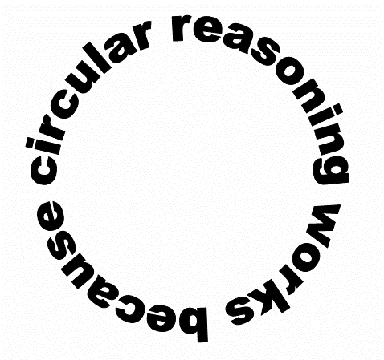
who is healthy?
“Healthy individuals are those free from disease”.
“Diseases are diagnosed based on differences from healthy individuals”

Slide 5
Health and sickness
Modern medicine is based on nosology, i.e. a systematic classification of diseases that mainly emerged at the end of the 19th century
On the other hand, our concept of healthiness, is not based on a classification. It relies on a more archaic, and naturalistic concept of individual well being.
We don’t have a test (a reference standard) to distinguish a well person from a sick one.

Slide 6
Different aspects of the concept of normality
Definition
Discipline
i
Term
1.
Probabilistic
Statistics
Gaussian (or other)
2.
Most common
in its category
Descriptive sciences
Modal
3.
Common in its category
Descriptive sciences
Habitual
4.
Most suitable to survive
Genetics
Best adapted
5.
Without any disease
Clinical medicine
Healthy
6.
Best in its category
Moral philosophy
Ideal
Mod. From Murphy EA. Perspect Biol Med 1972

Slide 7
“Normal” values for continuous laboratory variables
The Gaussian Model
Mean ± 2 SD
8
8
2.5%
95%
2.5%
Notes:
7

Slide 8
“Normal” values for continuous laboratory variables
The percentile approach
95th percentile
of the “normal population”
Notes:
8

Slide 9
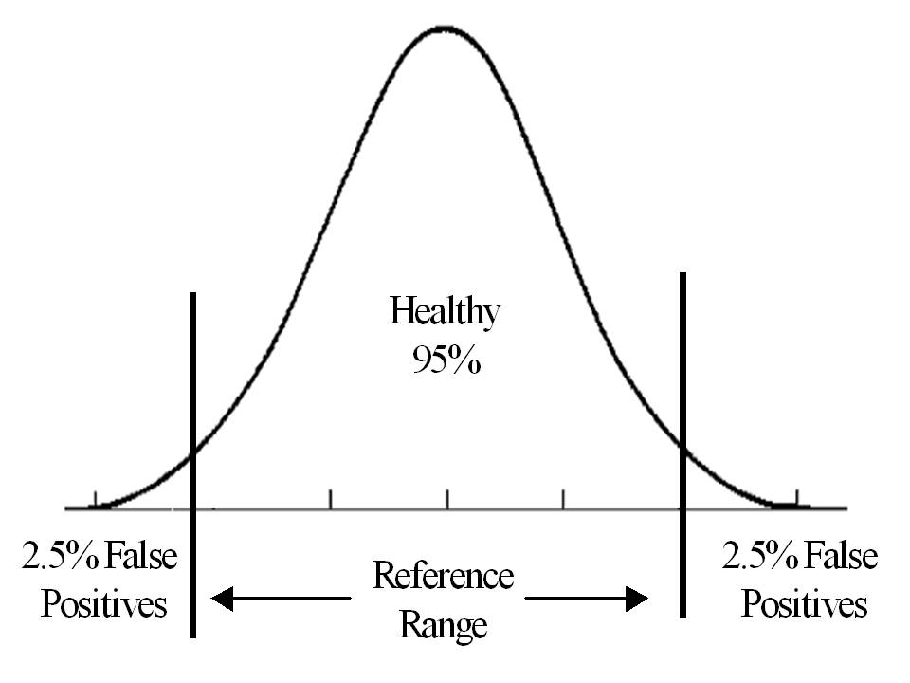
Accepted misclassifications when using a gaussian approach to define the reference ranges

Slide 10
Probability for an individual to be called normal when subjected to different numbers of diagnostic tests
Number
of
Probability
of
Calculation
tests
testing”normal”
1
0.95
95%
2
0.95
2
90%
20
0.95
20
35%
100
095
100
0.6%
Sackett and Haynes. The architecture of diagnostic research

Slide 11

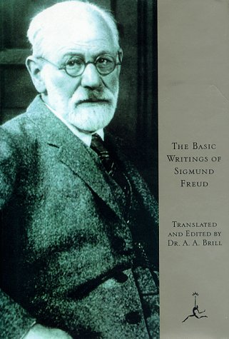
“Every normal person, in fact, is only normal on the average.”
S. Freud
Analysis Terminable and Interminable, 1937
IT’S A STATISTICAL CONCEPT
“His ego approximates to that of the psychotic in some part or other and to a greater or lesser extent”.
REQUIRES INDIVIDUALIZATION
Notes:
11
The concepts of this talk can be summarized in a short quotation.

Slide 12
“Normal” or “reference” values?

Slide 13
Changing terminology
“Normal ranges”
Should be replaced by
“Reference ranges”
When calculated from and/or referred to apparently healthy subjects
“Health related reference ranges”
“Healthy ranges”

Slide 14
Reference values can be simplistic
← !!!!
Acceptable
reference
population
Healthy individuals
At risk for
complication
Responders
or cured

Slide 15
However, reference values definition is just one of the possible approaches for cutoff setting

Slide 16

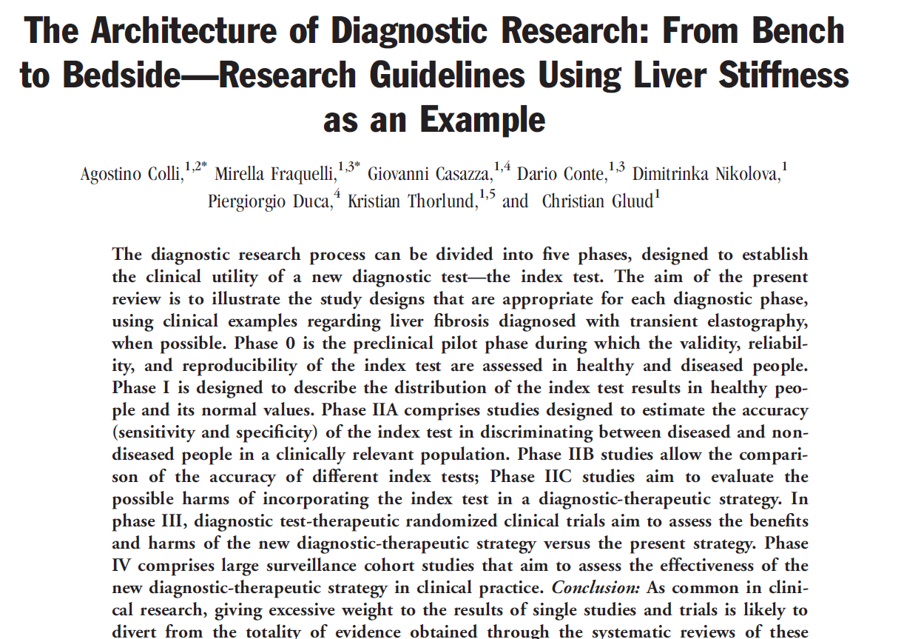

Slide 17
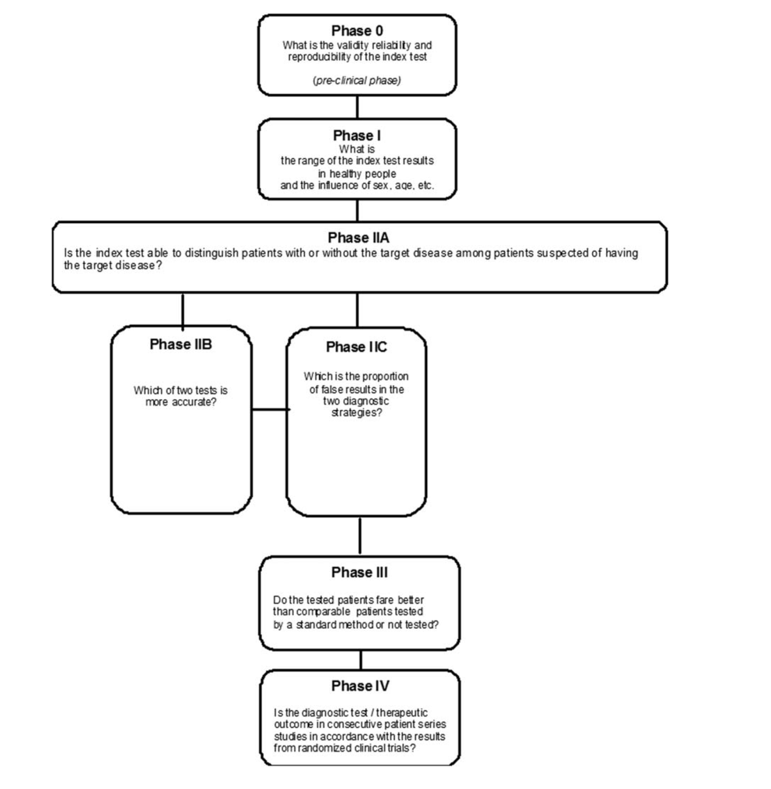


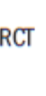
Setting cutoffs
Using cutoffs
(or comparing cutoff)
to predict outcomes
Colli A, Fraquelli M, et al., Hepatology 2014

Slide 18
Risk of disease
Continuous variable
“LOW” levels
“HIGH” levels
THRESHOLDS
Specificity
Sensitivity
Notes:
In effetti, per ogni variabile quantitatitiva, ll concetto di soglie differenziate corrispondenti a diversi livelli di sensibilità e specificità appare più appropriato rispetto a quello di normalità, radicato a una definizione dicotomica.

Slide 19
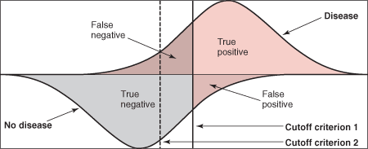
Distributions of test results
Changing the cutoff criterion from 1 to 2 (i.e., lowering the threshold)
decreases the number of false negatives (increases sensitivity)
increases the number of false positives (decreases specificity).

Slide 20
Possible approaches for cutoff setting:
“Healthy ranges”: in a population at low risk for disease (clinical and subclinical)
Diagnostic thresholds: in subjects with disease
  Thresholds to exclude complication
  To confirm complication
Outcome studies: (morbidity and mortality)
  Among healthy subjects
  Among subjects at risk for complications
Individual reference ranges: the reference subject is the subject
himself when he/she was healthy or uncomplicated (“reference
change values”)

Slide 21
Outline
The concept of normality, and some considerations about the definition of reference ranges
Healthy ranges and other cutoffs for the diagnosis liver injury
Notes:
Today I will try to to introduce the….

Slide 22
Different approaches to define cutoffs for alanine aminotransferase
“Low risk population”: values observed in subjects at low risk for liver disease (exclude those at high risk including HBV, HCV, alcoholic, NAFLD, etc)
“Mortality definition”: the values predicting mortality for chronic liver disease
“Therapeutic definition”: values observed in individuals cured from liver disease (eg, SVR for hepatitis C)
Notes:
Ma come possiamo identificare queste soglie?
Sono stati impiegati fondamentalmente 3 approcci, talora associati tra loro. Il primo è quello della definizione di popolazione a basso rischio (attraverso l’esclusione dei soggetti ad alto rischio), il secondo si bassa sul valore in grado di predire un outcome importante cioè la mortalità per malattia di fegato, il terzo su ina definizione terapeutica, cioè nei valori che siamo ingrado di osservare nei soggetti guariti dall’infezione.

Slide 23
Different ALT thresholds for different clinical outcomes
120
ALT U/L
100
??
80
in 10 yrs
60
in 30 yrs
Risk of decompensation
or HCC in HCV pts
?
40
Intracranial hemorrage
Any histological disease in CLD pts
Death for CLD in the general population
20
0
Outcomes
Notes:
E, come vedete esemplificato in questo cartone, le soglie devono essere comunque dimensionate agli obiettivi clinici che ci poniamo: ad esempio, una soglia di 30 U/L potrà andar bene per migliorare l’identificazione delle epatopatie di ogni gravità o per predire la mortalità nella popolazione generale, mentre dovremo incrementare queste soglie per esempio sei nostro obiettivo è predire la comparsa di scompenso o epatocarcinoma a breve o a medio termine nei malati con epatite C.

Slide 24
ALT use in the early 2000s
Poor sensitivity for diagnosing liver disease
Technical standardization was lacking
ALT was (improperly) used as a marker of fibrosis
Reference values had not been critically updated after the ‘golden age’ of enzymology (i.e., 70s-80s)
‘Reference populations’ proposed by laboratories contained substantial proportions of subjects with subclinical liver disease (HCV, NAFLD, etc)

Slide 25
The healthy population for a liver disease targeting test
Take a symptom free population (blood donors, general population etc)
Exclude viral hepatitis carriers
Exclude subjects at higher risk for metabolic syndrome/steatosis, eg:
  High serum lipids/tryglicerides
  High glucose levels
  Overweight individuals
  Heavy drinkers
  ….
Calculate reference intervals (95th centile)

Slide 26
Updated limits for ALT activity
6,835 blood donors
“Historical” upper limits |  | “Healthy” upper limits (population at low risk for liver disease)*
40 U/L males 30 U/L females |  | 30 U/L males 19 U/L females
(*) Normal BMI, triglycerides , cholesterol, and glucose levels; absence of concurrent medication use
Prati D et al, Ann Intern Med 2002
Notes:
. Su questa base abbiamo disegnato una popolazione cosiddetta a basso rischio per malattia di fegato e abbiamo potuto osservare una sostanziale riduzione delle sogli raccomandabili rispetto ai nostri valori storici - da 40 a 30 nei maschi, da 3 a 19 nelle femmine.

Slide 27
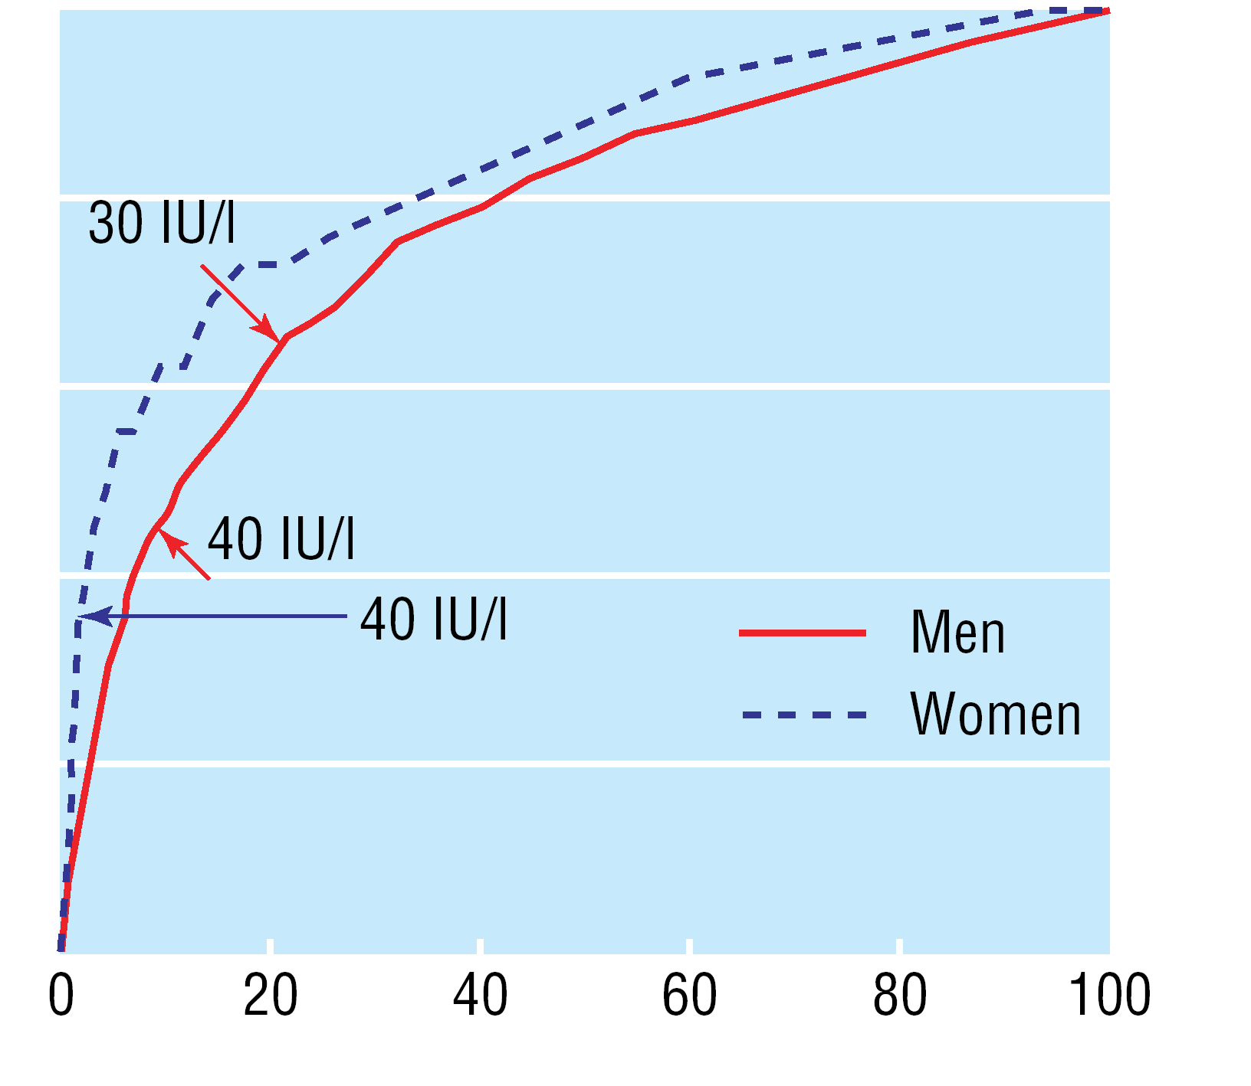
“Receiver operating characteristic (ROC) curves of serum ALT for identification of people at risk of death from liver diseases
100
Sensitivity (%)
80
60
40
20
0
Chang Kim H et al, BMJ 2004
1-Specificity (%)
Notes:
E sulla base dei loro risultati, I ricercatori sono stati in grado di osservare che la soglia migliore in grado di predirre la mortalità era la setssa da noi precedentemnte suggerita

Slide 28
“Therapeutic definition” of upper normal limit for ALT
Population: 2881 patients included in 3 trials using pegylated IFN + Ribavirin
Threshold: 95th percentile in of ALT in sustained virological responders
25% reduction
E.g.
30 U/L
Historical thresholds
(Lab-specific)
E.g.
40 U/L
Prati D et al., J Hepatol 2006
Notes:
Abbiamo retrospettivamente valutato I risultati raccolti in 3 megatrial per la validazione di IFN e RIBA nella pratica clinica. I valori, calcolati nei responders virologici al trattamento,

Slide 29
ALT cutoffs determined with different approaches
Approach | New thresholsds (U/L) | Reduction from to historical thresholds | Reference
Low risk population | 30 in males, 19 in females | 25-35% | Prati, Ann Int Med 2002
Mortality | 30 in males | 25% | Kim, BMJ 2004
Therapeutic efficacy | -- (Expressed as xULN) | 27% | Prati, J Hepatol 2006
D.Prati, Food and Drug Administration Lecture, 2015
Notes:
Dunque, riassumendo, gli studi che si sono proposti, in questi anni, di rivalutare l’adeguatezza dei limiti di riferimento per le ALT sono giunti alla conclusione che i limiti “ripuliti” da malattia sono circa il 25-30% più bassi rispetto a quelli correntemente impiegati: questo usando approcci analitici piuttosto diversi, quali la definizione della popolazione a basso rischio, la mortalità per per malattia di fegato nella popolazione generale, oppure il margine di riduzione ottenibile dopo trattamento dell’epatite C.

Slide 30
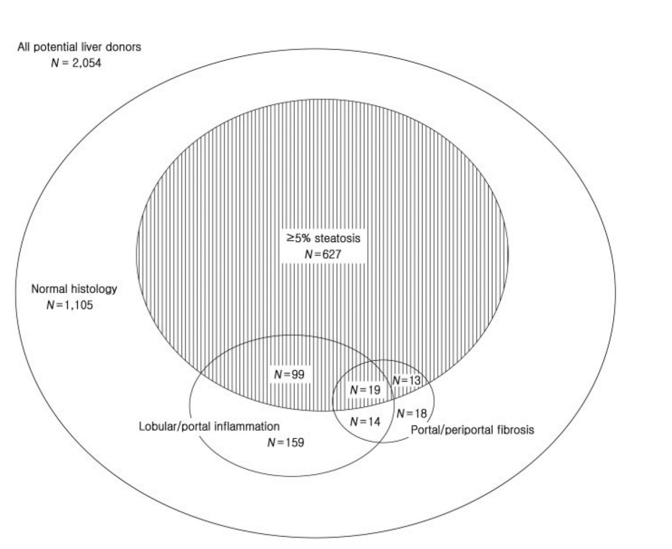
“Among the 665 individuals(346 men and 319 women) selected according Prati criteria,
healthy ALT values were 33 IU/L for men and 25 IU/L for women”.

Slide 31
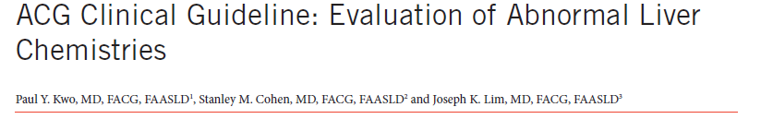
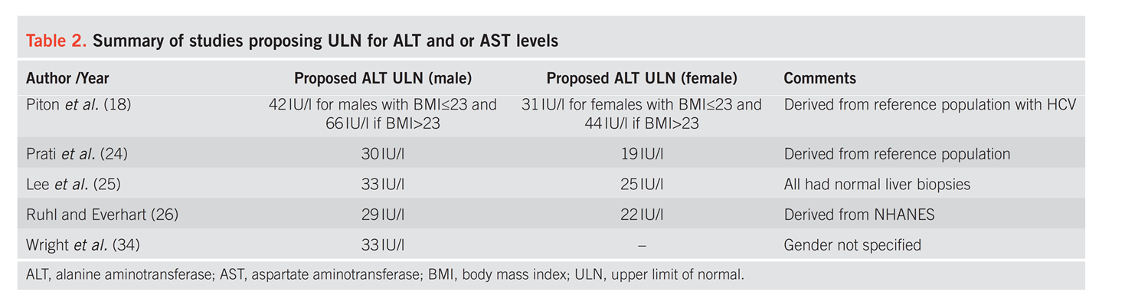
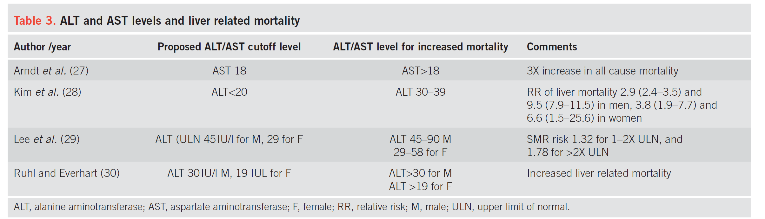
“A true healthy normal ALT level ranges from 29 to 33 IU/l for males, 19 to 25 IU/l for females”.

Slide 32
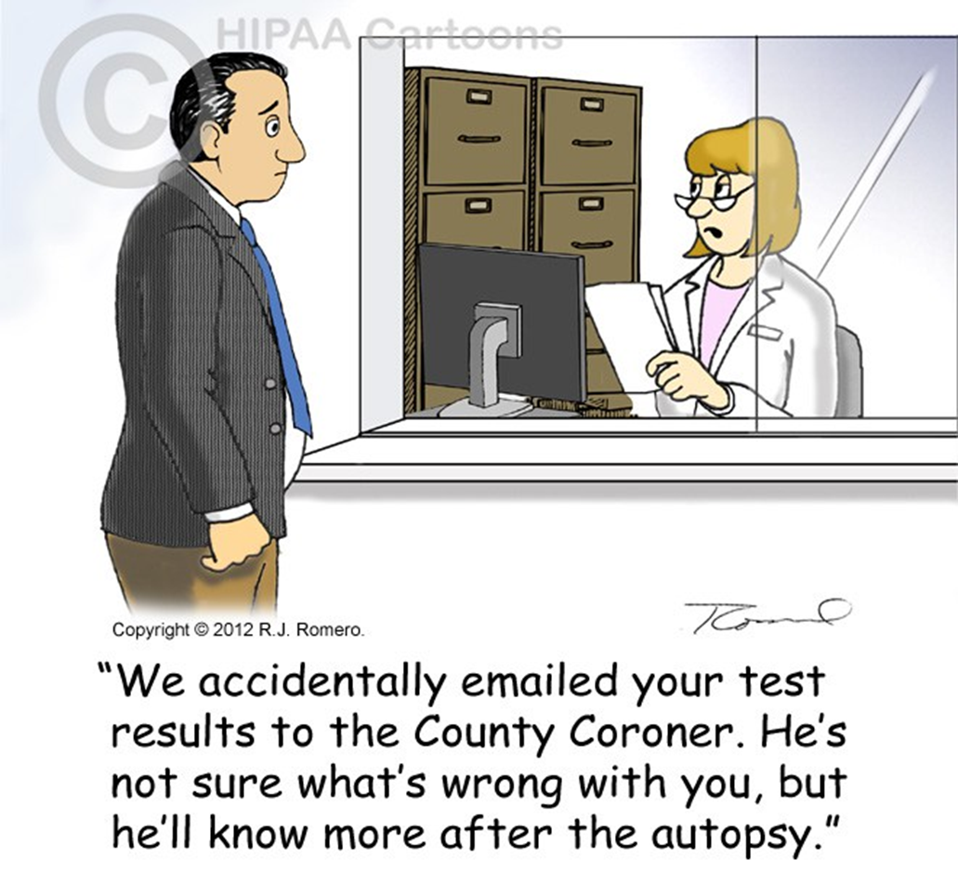
Caution must be paid when using healthy ranges for testing healthy individuals outside a clear clinical indication

Slide 33
Accepted misclassifications when using a gaussian approach to define the reference ranges

Slide 34
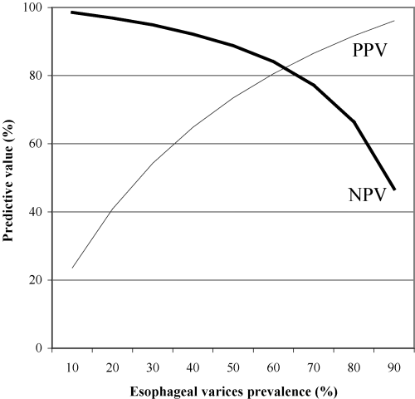
Predictive values by prevalence example:
Plot of positive predictive values (PPV, thin line) and negative predictive values (NPV, solid line) of a platelet count/spleen diameter ratio 909 cutoff versus various arbitrary prevalence of esophageal varices.
Giannini E et al, AJG 2006

Slide 35
“A well person is a patient who has not been completely worked up”.
Wellness cannot be screened for. There is no substance in blood or urine whose level is reliably high or low in well people. No radiologic shadows or images indicate wellness. There is no tissue that can undergo biopsy to prove a person is well. Wellness cannot be measured, yet we seek it with analytic methods.
The demands of the public for definitive wellness are colliding with the public's belief in a diagnostic system that can find only disease. A public in dogged pursuit of the unobtainable, combined with clinicians whose tools are powerful enough to find very small lesions, is a setup for diagnostic excess. And false positives are the arithmetically certain result of applying a disease-defining system to a population that is mostly well.

Slide 36
Messages
The definition of “healthy ranges” is only a first step in the evidence based diagnostic research. Other cutoffs should ideally be identified on the basis of prospective studies, based on clinical outcomes.
Ultimately, recommendations for values to be employed in clinical practice derive from a critical analysis of studies conducted with different approaches.
For liver enzymes, such studies were conducted during the last decade, and suggest that the healthy ranges for ALT can be provisionally set around 30 U/L in males, and 20-25 U/L in females.
However, the simplistic approach of a universal cutoff value valid for all clinical situations should be abandoned. Results should be interpreted flexibly, taking into account the scope of the test and the patient’s characteristics.

Slide 37



Thank you!

