Slide 1
Analysis of diagnostic studies: defining the questions, study phases, and designs
P.G. Duca, D. Prati

Slide 2


Slide 3
Case presentation
A man in his early 40s presented to his primary care physician with intermittent anxiety attacks and progressive fatigue. An active duty service member, the patient had a history of panic disorder since deployment to Iraq 6 years earlier.
Between his anxiety attacks, he had also developed severe fatigue characterized by persistent feelings of tiredness and a generalized sense of weakness.
Three months prior to presentation, he changed duty stations to a more remote post in Eastern Asia. Almost immediately after arrival at his new post, he noted worsening of his panic disorder symptoms. He had been using lorazepam as needed, which provided little relief. He had also recently been prescribed venlafaxine, which he had to stop taking owing to feelings of light-headedness.

Slide 4
Case investigation
The patient’s physician ordered laboratory studies to evaluate the fatigue, including serum ammonia and cortisol analysis and a mononucleosis screen.
Owing to limited resources at the clinic, the ammonia specimen was frozen in an ethylenediamine tetraacetic acid tube and sent to a laboratory in California for processing, which took more than a week to send the results.
  Ammonia: 643 µg/dL (reference range, 27-102 µg/dL).
  Alanine aminotransferase (ALT): 89 U/L (reference range 21-72 U/L)
  γ-glutamyltransferase (GGT) : 81 U/L (reference range, 15-73 U/L).
  Right upper quadrant ultrasonography revealed limited hepatic steatosis.

Slide 5
Case workup and conclusions
With no clear hepatic cause for the hyperammonemia, there were concerns for a partial urea cycle disorder.
Therefore, the patient was transferred to a tertiary care center in the United States for further evaluation.
Under the direction of a medical geneticist, he underwent an extensive laboratory workup, both before and after a large protein load, to include urine amino acids, urine organic acids, and plasma amino acids.
All studies returned with normal values. Additionally, all subsequent ammonia levels came back within normal limits, suggesting that the initial elevation was a false elevation.
The patient returned to his overseas duty assignment after an approximate 30-day stay in the United States.

Slide 6
Discussion 1
What are the possible causes for misdiagnosis in this patient?

Slide 7
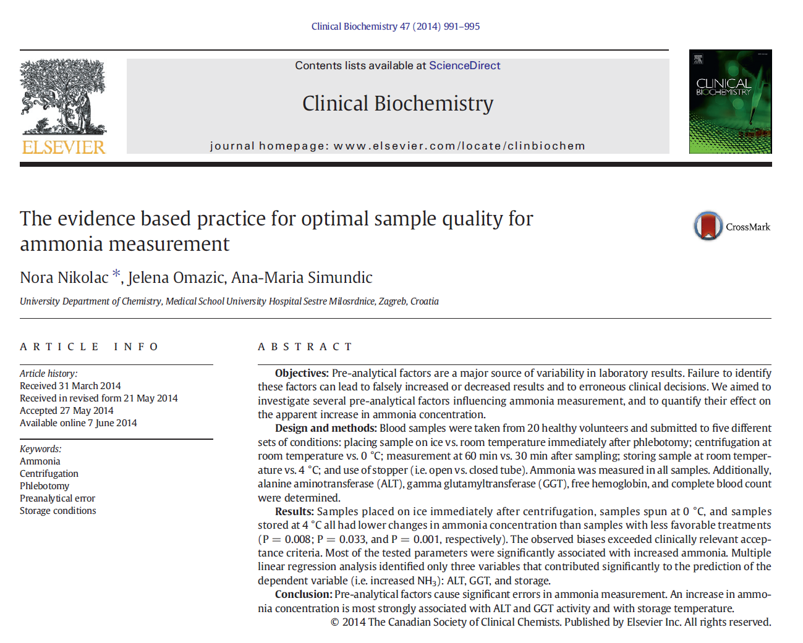

Slide 8
Aims and study protocol
The effect of several factors potentially influencing ammonia measurement (sample temperature, centrifugation temperature, storage time and temperature, use of stoppers, and concentration of some biochemical and hematological parameters) was quantified.

Slide 9
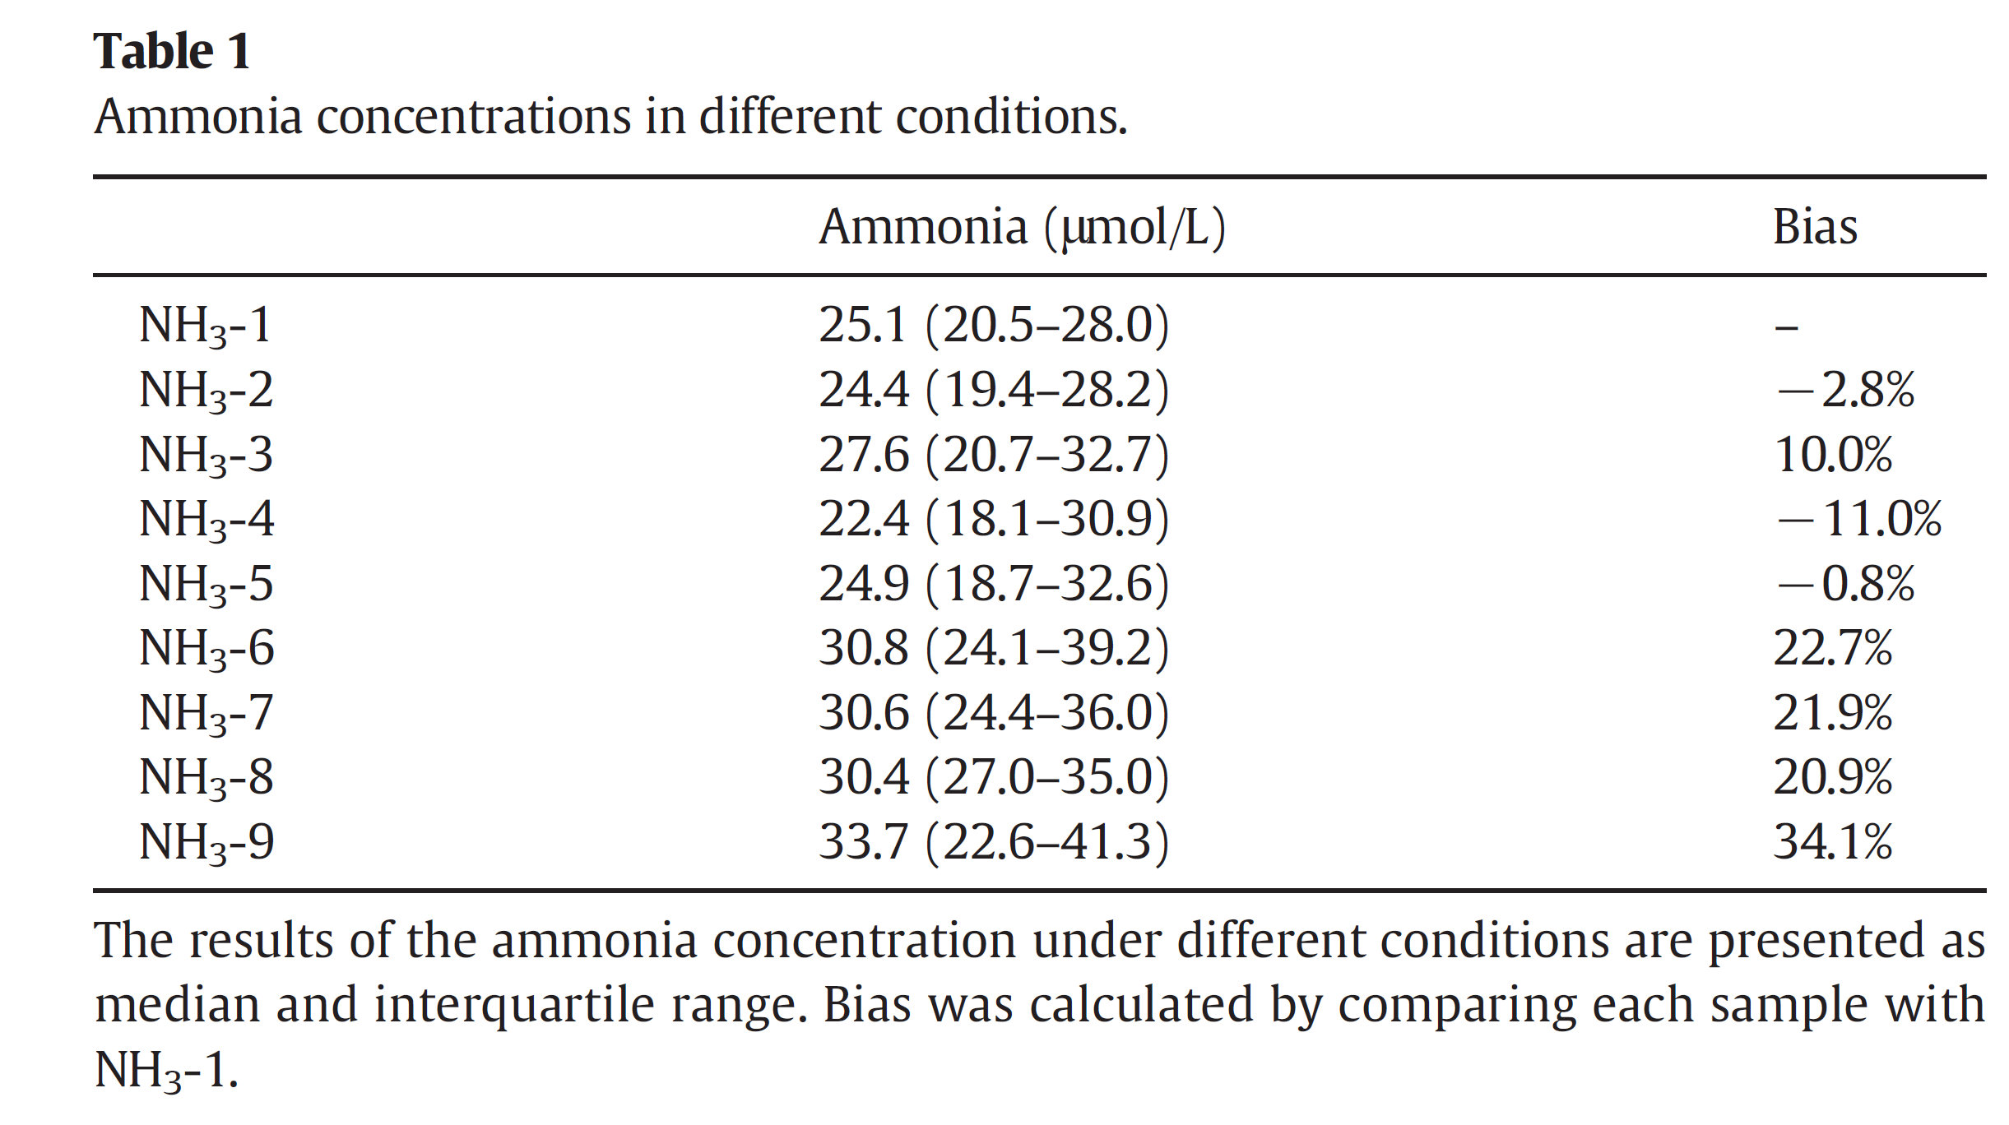

Slide 10
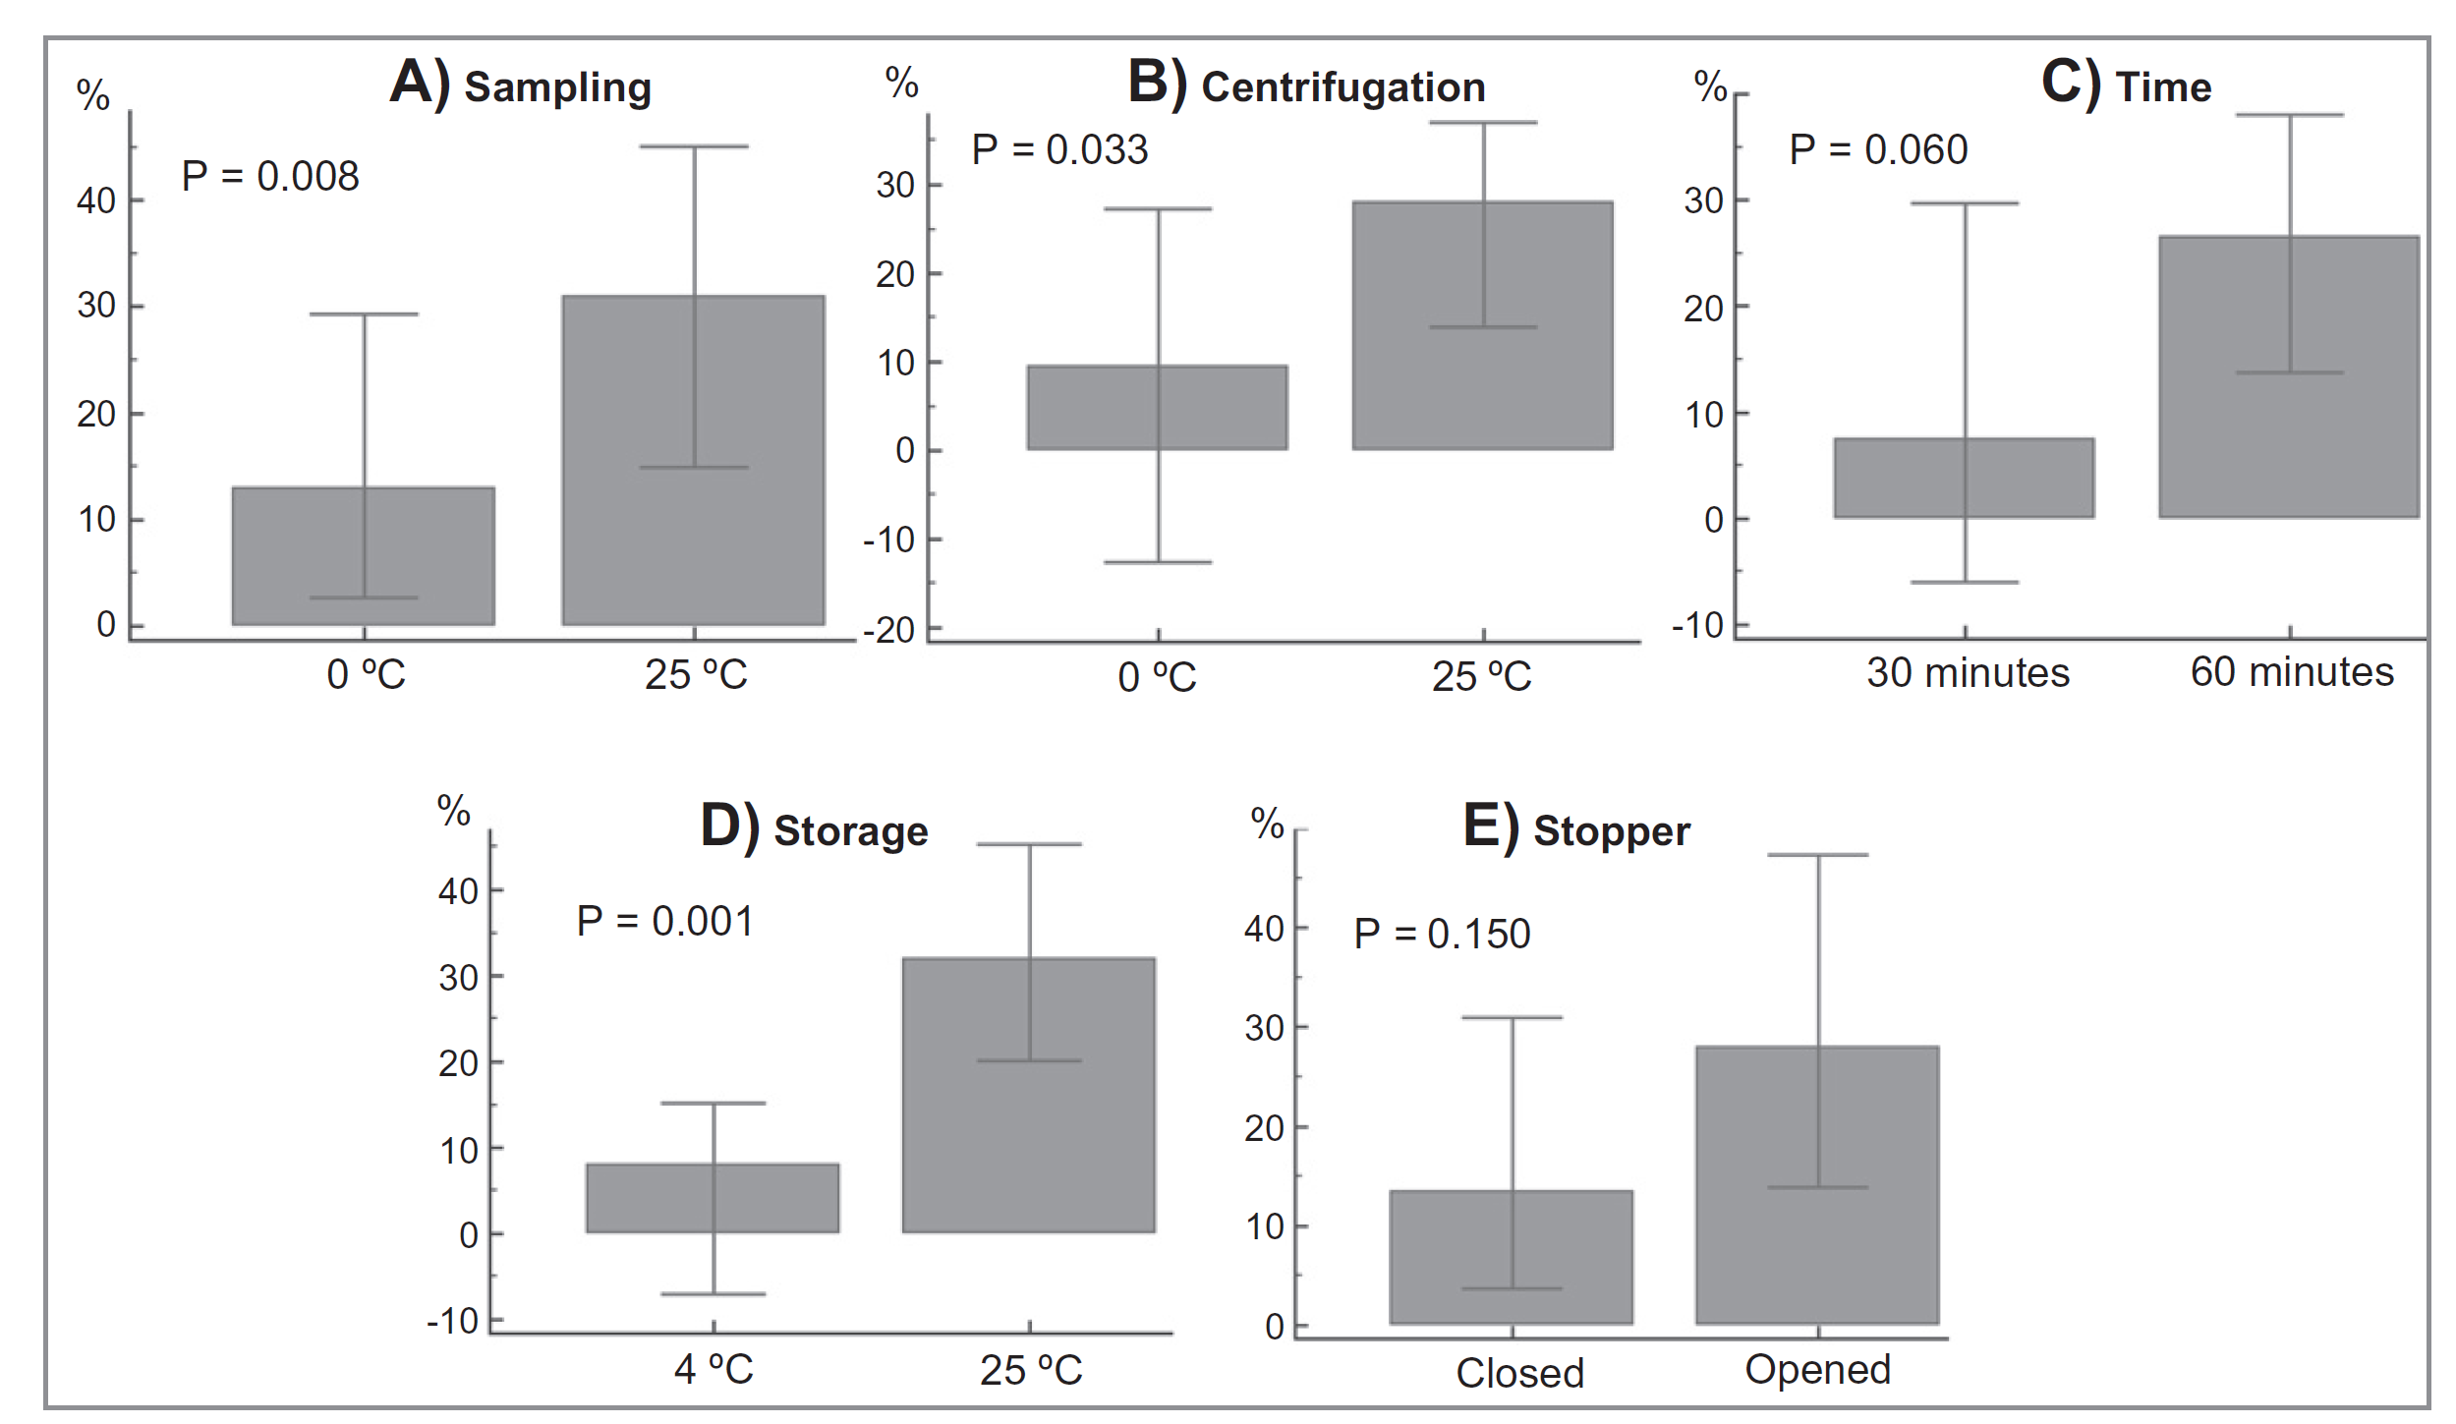
Comparison of changes in ammonia concentration between different treatment conditions

Slide 11
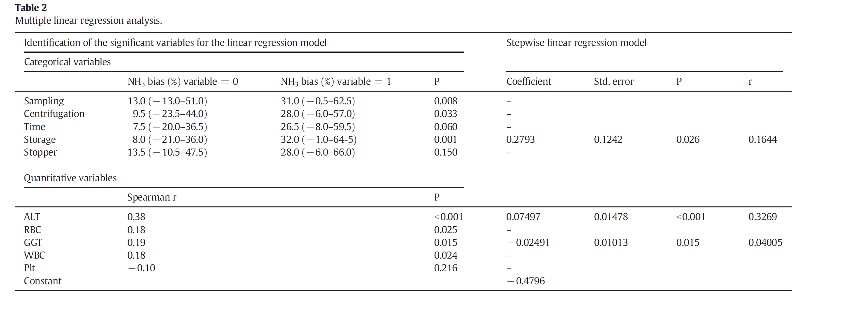
Multiple linear regression analysis
Three variables contributed significantly to the prediction o. increased NH3: ALT, GGT, and storage.

Slide 12
Discussion 2
Identify the study phase and design
Briefly review the first two steps of diagnostic research (phase 0 and phase I)
Please comment about the risk of prescibing tests without a definite indication

