Slide 1
Diagnostic accuracy and statistical significance
Mirella Fraquelli
Gastroenterology and Endoscopy Unit
Fondazione IRCCS Ca’ Granda
Ospedale Maggiore Policlinico - Milan
DIAGNOSIS: the pathway of a diagnostic test from bench to bedside. Basic residential course
4-8 April 2017 - Palazzo Feltrinelli
Gargnano, Lake Garda, Italy

Slide 2
Aim of diagnostic studies
In clinical practice diagnosis is not an aim per se
The fundamental purpose of diagnostic testing is to reduce uncertainty about the presence or absence of the disease in order to reduce the risks of an improper treatment decision
Diagnosis is relevant in as far as it directs treatment and indicates the prognosis of a patient presenting with a particular problem

Slide 3
Aim of diagnostic studies
Different measures of diagnostic accuracy relate to the different aspects of diagnostic procedure:
some measures are used to assess the discriminative property of the test (accuracy)
others measures are used to assess the predictive ability of the test (prognosis)

Slide 4
Aim of diagnostic studies
The importance of statistical significance is overplayed in many diagnostic studies
For a diagnostic test being clinically useful the relationship between Test and Disease must be very strong
Therefore, unless the sample size is very small, it is likely that clinically important results are also statistically significant

Slide 5
However…..
Diagnostic testing
Statistical
significance
Clinical
Relevance
==

Slide 6
Figure 1
Phase IV
Is the diagnostic test / therapeutic outcome in consecutive patient series studies in accordance with the results from randomized clinical trials?
Phase III
Do the tested patients fare better
than comparable patients tested
by a standard method or not tested?
phase IIa
Which of the two tests is more accurate?
phase IIb
What is the proportion of false results in the two diagnostic strategies?
Phase II
Is the index test able to distinguish patients with and without the target disease among patients suspected of having the target disease?
Phase I
What are the range of the index test results in healthy people and the influence of sex, age, BMI etc.
Phase 0
What are the validity, reliability and
reproducibility of the index test
(pre-clinical phase)

Slide 7
Does statistical significance really matter?

Slide 8
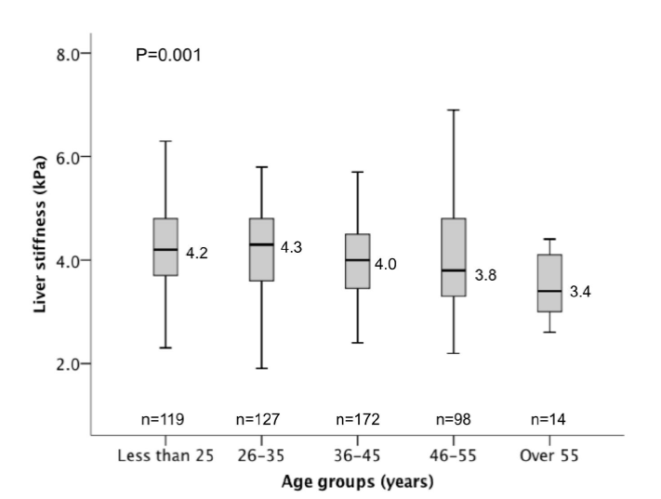
Does statistical significance really matter? Phase 0-1 and preliminary 2
Fung et al. WJG 2013

Slide 9
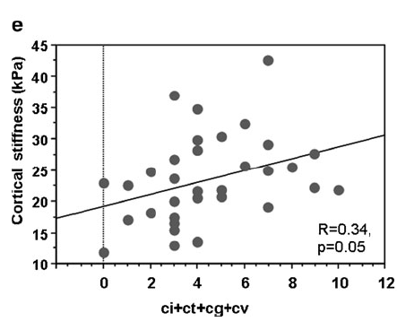
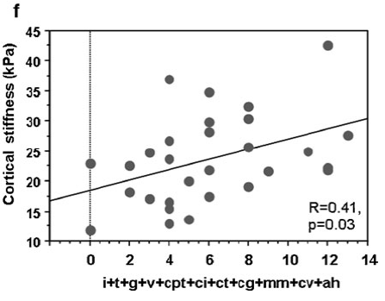
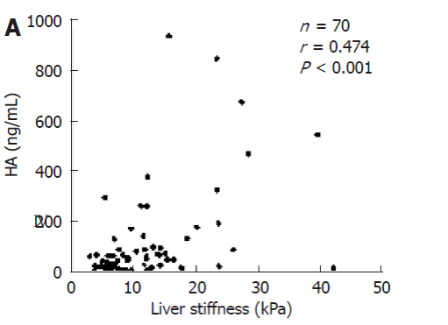
Correlations
Greniol et al. Eur Rad 2012
Takeda et al. WJG 2006

Slide 10
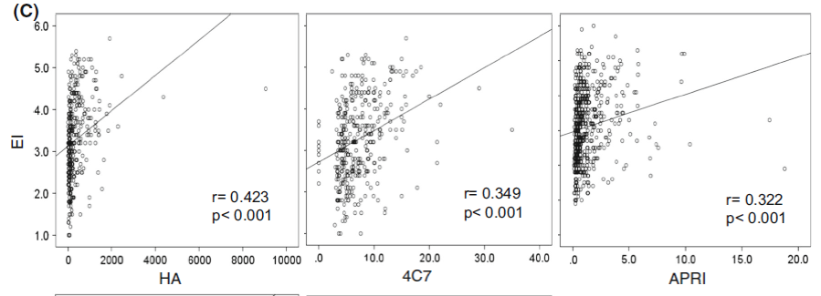
Taijiri et al. J Gastroenterol 2016

Slide 11
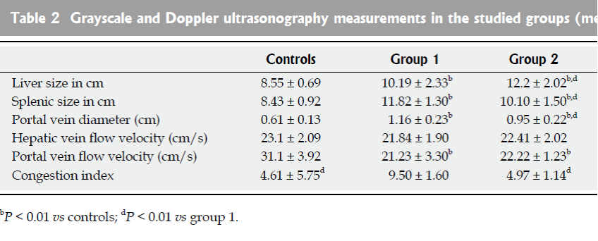
Value of duplex doppler US
in non-invasive assessment of children with CLD
Group 1: 13 cirrhotics Group 2: 12 Chronic Hepatitis
Shabrawi et al. WJG 2010

Slide 12
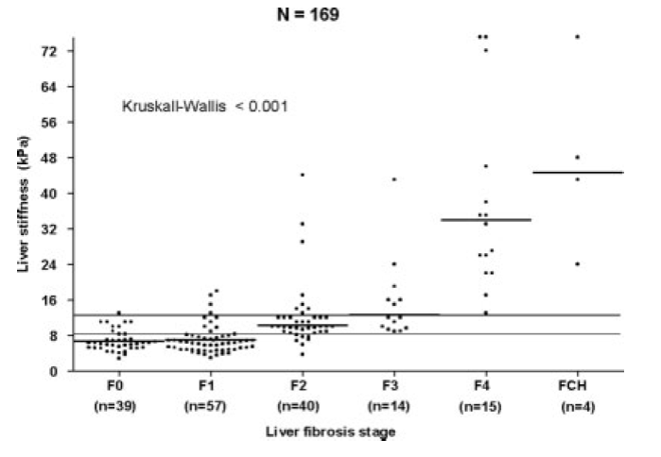
Transient Elastography for the diagnosis of advanced Fibrosis and Portal Hypertension in patients with Hepatitis C Recurrence after Liver Transplantation
Carrion et al. Liver Transplan 2006

Slide 13
Does statistical significance really matter?
Phase 0-1 and preliminary 2
Not always the diagnostic accuracy of an IT will lead to a clinical advantage for the patient
Comparisons between means (medians) are probably not useful in these cases
When analyzing the results of a diagnostic study one should always look at data distribution (graphical data representation)

Slide 14
Phase 2
Aim: To validate FibroTest, SteatoTest and ActiTest in NAFLD patients
Population: 600 NAFLD adult patients who underwent the three tests
and liver biopsy (RS)
Munteaunu et al. APT 2016

Slide 15
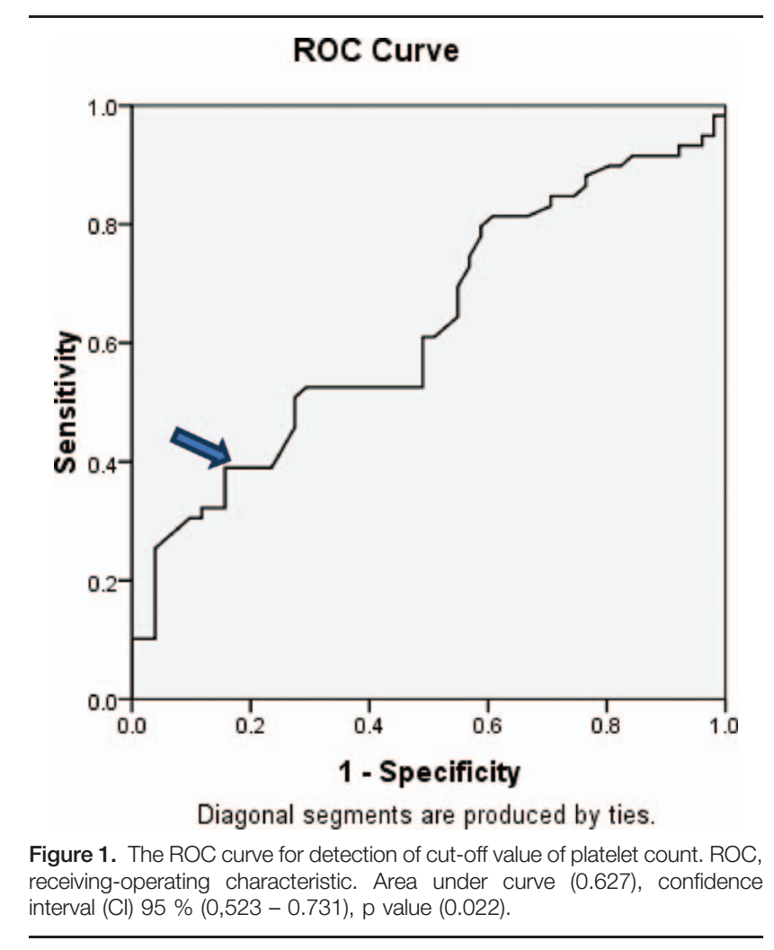
Correlation of platelets count with endoscopic findings in a cohort of Egyptian patients with liver cirrhosis.
Medicine (2016) 95: 23

Slide 16
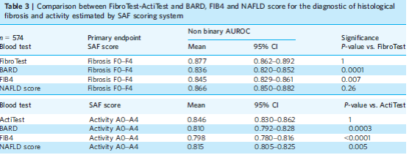
ta
Given the big sample size even small differences
are statistically significant
Munteaunu et al. APT 2016

Slide 17
Does statistical significance really matter? Phase 2
AUROC is a measure of overall accuracy, useful for comparing different diagnostic techniques, but with a low absolute value
The use of different thresholds can help

Slide 18
100 consecutive patients with HCV-related cirrhosis underwent
non-invasive methods to detect esophageal varices
RS: Upper Endoscopy
Diagnostic thresholds
Colecchia et al. Gastroenterology 2012

Slide 19
Aim of diagnostic studies
Highly specific test:
to reduce FP results
Highly sensitive test:
to reduce FN results
?
Effect on clinically relevant outcomes

Slide 20
311 patients with HCV-related cirrhosis:
PTL/spleen size (cut-off 909) and upper endoscopy
Esophageal varices (EV) prevalence: 49%
PTL/spleen size (predefined cut-off 909):
100% sensitivity, 96.8% specificity, LR+ 31.8, LR- 0.01
Agha et al. Dig Dis Sci 2009

Slide 21
c-index = AUC
Agha et al. Dig Dis Sci 2009

Slide 22
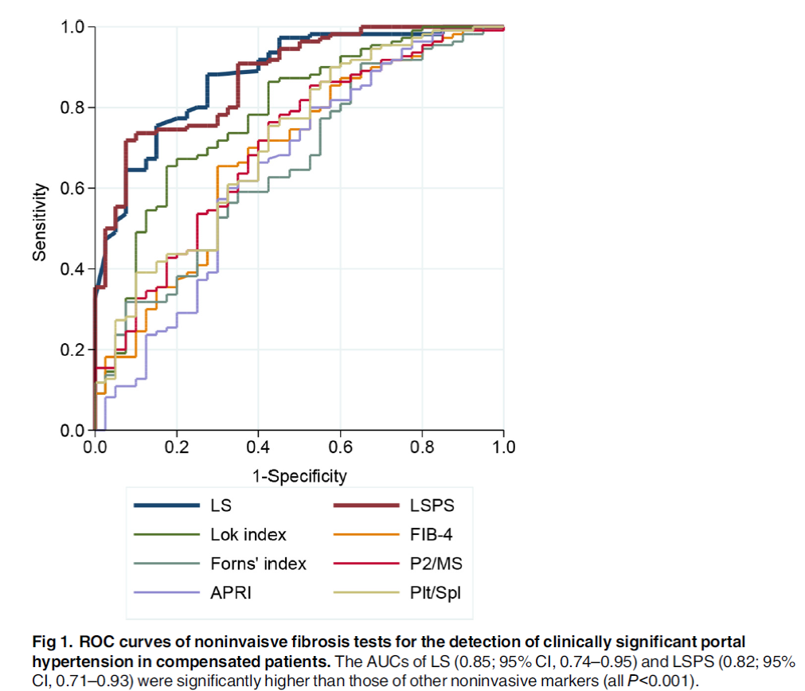
219 consecutive alcoholic
cirrhosis patients
Cho et al. Plos One 2015

Slide 23
Phase 2B
518 patients with compensated advanced CLD
IT:
LSM
PTL count
spleen diameter
RS: upper endoscopy
Risk prediction MODEL
Predefined the accepted FN (5%)
Decisional thresholds:
(BAVENO VI) 5% risk of missed VNT (PTL >150
and LSM <20 kPa) (FN)
Outcome:
VNT: varices needing Tx
Albrades et al. Hepatology 2016

Slide 24
Does statistical significance really matter? Conclusions
Statistical significance does not always mean clinical relevance
It is crucial to state the role of the IT, the aim of diagnosis in a given context and its effects in terms of clinically relevant outcomes
AUC can be used for raw comparisons (assuming that FP and FN have the same weight)
In order to define the IT role and usefulness it is key to predefined the type error to avoid and to choose an appropriate model (threshold approach)

