Slide 1


The receiver operating characteristic (ROC) curve
DIAGNOSIS: the pathway of a diagnostic test from bench to bedside. Basic residential course.
Outline
Giovanni Casazza
April, 4 - 8, 2017 - Palazzo Feltrinelli - Gargnano, Lago di Garda, Italy

Slide 2
Outline
Effect of cut-off variation on sensitivity and specificity
Graphical representation of the relationship between sensitivity and specificity (ROC curve)
A summary measure of the overall accuracy (AUC)
Reading a ROC curve

Slide 3
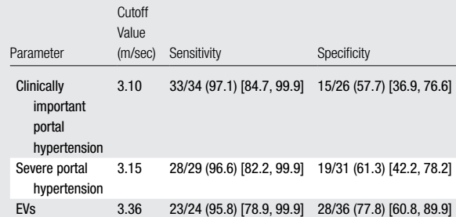
A diagnostic accuracy study: spleen sriffness
Spleen stiffness: continuous measurement

Slide 4
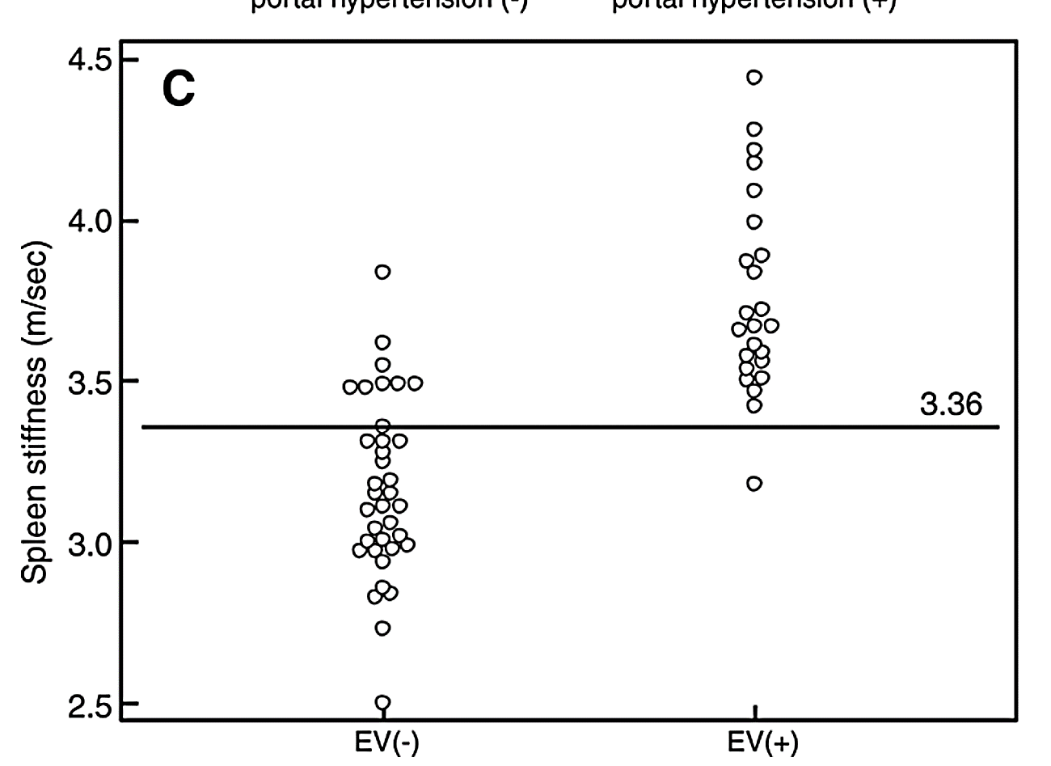
Continuous index test results
Test +
Test –
n=36
n=24

Slide 5
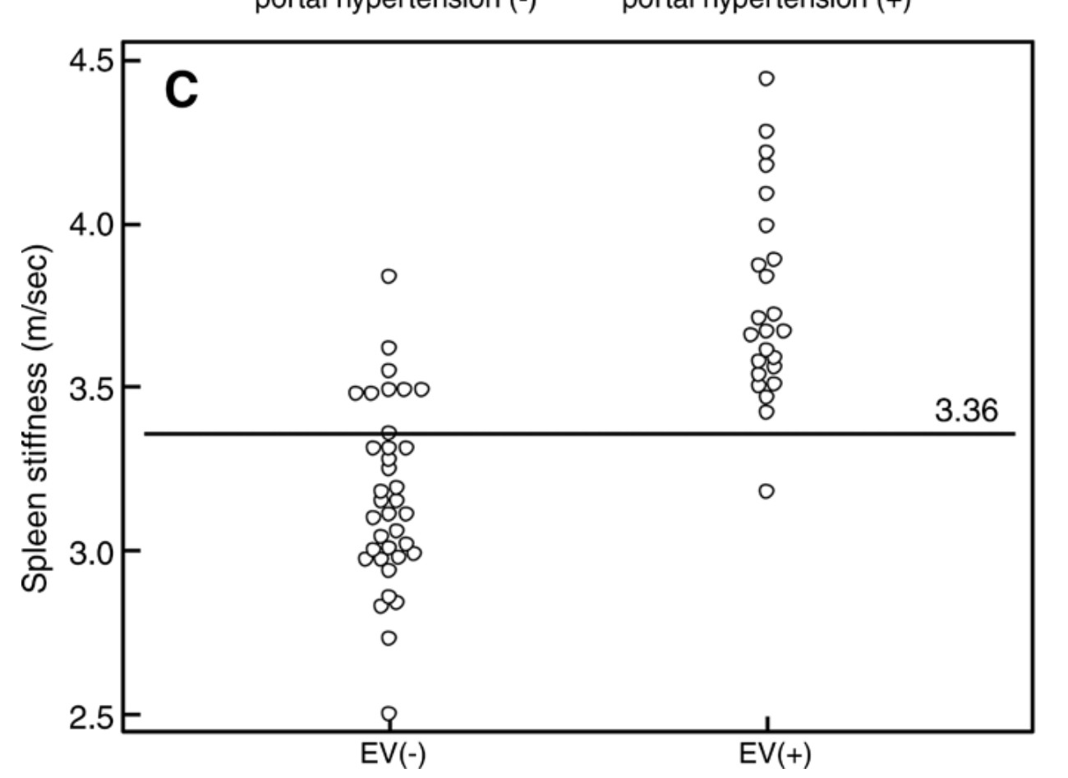
Continuous index test results
Test +
Sensitivity: 23/24=95.8%
23/24 test +
1/24 test –
Test –
n=36
n=24

Slide 6
Continuous index test results
Test +
Specificity: 28/36=77.8%
8/36 test +
28/36 test –
Test –
n=36
n=24

Slide 7
Continuous index test results
Sensitivity: 23/24=95.8%
Test +
Specificity: 28/36=77.8%
8/36 test +
28/36 test –
 | Any EV
 | + | –
+ | 23 | 8 | 31
– | 1 | 28 | 29
Tot | 24 | 36
FP
TP
TN
FN
23/24 test +
1/24 test –
Test –
n=36
n=24

Slide 8
Continuous index test results
Sensitivity: 6/24=25%
Specificity: 36/36=100%
0/36 test +
36/36 test –
6/24 test +
18/24 test –
3.95
n=36
n=24

Slide 9
Continuous index test results
Sensitivity: 9/24=37.5%
Specificity: 35/36=97.2%
1/36 test +
35/36 test –
9/24 test +
15/24 test –
3.75
n=36
n=24

Slide 10
Continuous index test results
Sensitivity: 11/24=45.8%
Specificity: 35/36=97.2%
1/36 test +
35/36 test –
11/24 test +
13/24 test –
3.68
n=36
n=24

Slide 11
Continuous index test results
Sensitivity: 15/24=62.5%
Specificity: 34/36=94.4%
2/36 test +
34/36 test –
15/24 test +
9/24 test –
3.59
n=36
n=24

Slide 12
Continuous index test results
Sensitivity: 23/24=95.8%
Specificity: 22/36=61.1%
14/36 test +
22/36 test –
23/24 test +
1/24 test –
3.25
n=36
n=24

Slide 13
Continuous index test results
Sensitivity: 24/24=100%
Specificity: 10/36=27.8%
26/36 test +
10/36 test –
24/24 test +
0/24 test –
3.00
n=36
n=24

Slide 14
Continuous index test results
Sensitivity: 24/24=100%
Specificity: 18/36=50%
18/36 test +
18/36 test –
24/24 test +
0/24 test –
3.15
n=36
n=24

Slide 15
The threshold
 |  | Any EV
 |  | + | –
SS >3.95 | + | 6 | 0 | 6
 | – | 18 | 36 | 54
 | Tot | 24 | 36
 |  | Any EV
 |  | + | –
SS >3.75 | + | 9 | 1 | 10
 | – | 15 | 35 | 50
 | Tot | 24 | 36
 |  | Any EV
 |  | + | –
SS >3.68 | + | 11 | 1 | 12
 | – | 13 | 35 | 48
 | Tot | 24 | 36
 |  | Any EV
 |  | + | –
SS >3.59 | + | 15 | 2 | 17
 | – | 9 | 34 | 43
 | Tot | 24 | 36

Slide 16
The threshold
 |  | Any EV
 |  | + | –
SS >3.36 | + | 23 | 8 | 31
 | – | 1 | 28 | 29
 | Tot | 24 | 36
 |  | Any EV
 |  | + | –
SS >3.25 | + | 23 | 14 | 37
 | – | 1 | 22 | 23
 | Tot | 24 | 36
 |  | Any EV
 |  | + | –
SS >3.15 |  | 24 | 18 | 42
 |  | 0 | 18 | 18
 | Tot | 24 | 36
 |  | Any EV
 |  | + | –
SS >3.00 | + | 24 | 26 | 50
 | – | 0 | 10 | 10
 | Tot | 24 | 36

Slide 17
Summary of thresholds - Table
Cut-off value | Test + | Test - | Sensitivity | Specificity
3.95 | 6 | 54 | 25 | 100
3.75 | 10 | 50 | 37.5 | 97.2
3.68 | 12 | 48 | 45.8 | 97.2
3.59 | 17 | 43 | 62.5 | 94.4
3.36 | 31 | 29 | 95.8 | 77.8
3.25 | 37 | 23 | 95.8 | 61.1
3.15 | 42 | 18 | 100 | 50
3.00 | 50 | 10 | 100 | 27.8

Slide 18
Trade-off between sensitivity and specificity
Unfortunately, as specificity increases, sensitivity decreases.
pt | SS | cut-off
 |  | 3.15 | 3.59 | 3.95
1 | 3.02 | - | - | -
2 | 3.14 | - | - | -
3 | 3.25 | + | - | -
4 | 3.40 | + | - | -
5 | 3.65 | + | + | -
6 | 3.80 | + | + | -
7 | 3.98 | + | + | +
8 | 4.05 | + | + | +
9 | 4.40 | + | + | +
As the cut-off increases:
only patients with higher SS values are classified as positive.
Less (true and false) positive patients;
more (true and false) negative patients.
Less true positives→ Sensitivity decreases
Sens=TP/(TP+FN)
Less false positives→ Specificity increases
Spec=TN/(TN+FP)

Slide 19
Trade-off between sensitivity and specificity
Unfortunately, as sensitivity increases, specificity decreases.
pt | SS | cut-off
 |  | 3.15 | 3.59 | 3.95
1 | 3.02 | - | - | -
2 | 3.14 | - | - | -
3 | 3.25 | + | - | -
4 | 3.40 | + | - | -
5 | 3.65 | + | + | -
6 | 3.80 | + | + | -
7 | 3.98 | + | + | +
8 | 4.05 | + | + | +
9 | 4.40 | + | + | +
As the cut-off decreases:
only patients with lower SS values are classified as negatives.
Less (true and false) negative patients;
more (true and false) positive patients.
More true positives→ Sensitivity increases
Sens=TP/(TP+FN)
More false positives→ Specificity decreases
Spec=TN/(TN+FP)

Slide 20
Summary of thresholds - Graphic
Cut-off value | Sensitivity | Specificity
3.95 | 0.250 | 1.000
3.75 | 0.375 | 0.972
3.68 | 0.458 | 0.972
3.59 | 0.625 | 0.944
3.36 | 0.958 | 0.778
3.25 | 0.958 | 0.611
3.15 | 1.000 | 0.500
3.00 | 1.000 | 0.278
Cut
-
off
Sensitivity
Specificity
1
-
specificity
value
3.95
0.250
1.000
0.000
3.75
0.375
0.972
0.028
3.68
0.458
0.972
0.028
3.59
0.625
0.944
0.056
3.36
0.958
0.778
0.222
3.25
0.958
0.611
0.389
3.15
1.000
0.500
0.500
3.00
1.000
0.278
0.722
1.0 0.9 0.8 0.7 0.6 0.5 0.4 0.3 0.2 0.1 0
Specificity

Slide 21
Summary of thresholds - Graphic
If we do the same for all the possible cut-off values
1.0 0.9 0.8 0.7 0.6 0.5 0.4 0.3 0.2 0.1 0.0
Specificity

Slide 22
The ROC curve
This curve is known as the Receiver Operating Characteristic (ROC) curve.
1.0 0.9 0.8 0.7 0.6 0.5 0.4 0.3 0.2 0.1 0.0
Specificity

Slide 23
The ROC curve
cut-off: 3.36
Sens=0.958
Spec=0.778
cut-off: 3.59
Sens=0.625
Spec=0.944
1.0 0.9 0.8 0.7 0.6 0.5 0.4 0.3 0.2 0.1 0.0
Specificity

Slide 24

The ROC curve
The area under the ROC curve (AUC) is a (summary) measure of diagnostic accuracy
AUC is a measure of the ability of the continuous index test to discriminate between diseased and non diseased
AUC=0.937
1.0 0.9 0.8 0.7 0.6 0.5 0.4 0.3 0.2 0.1 0

Slide 25
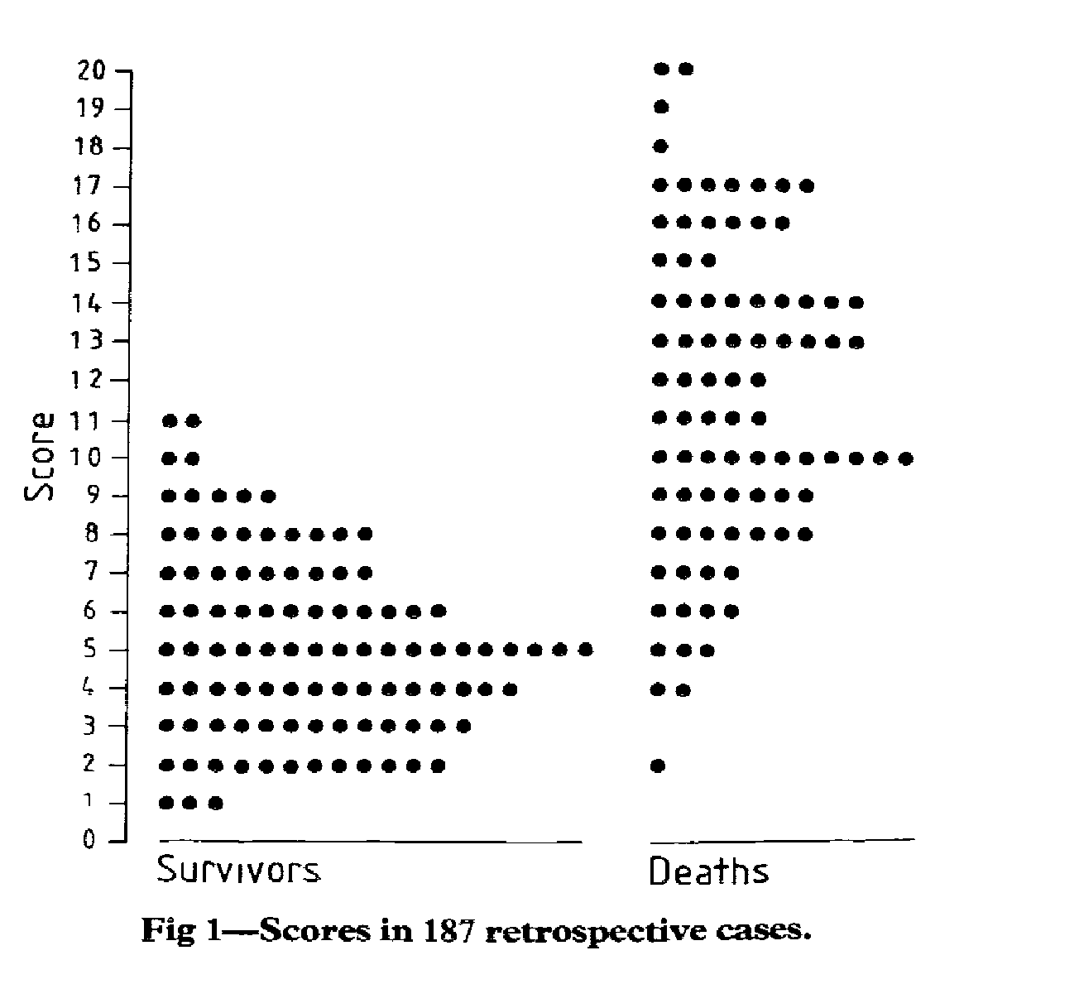
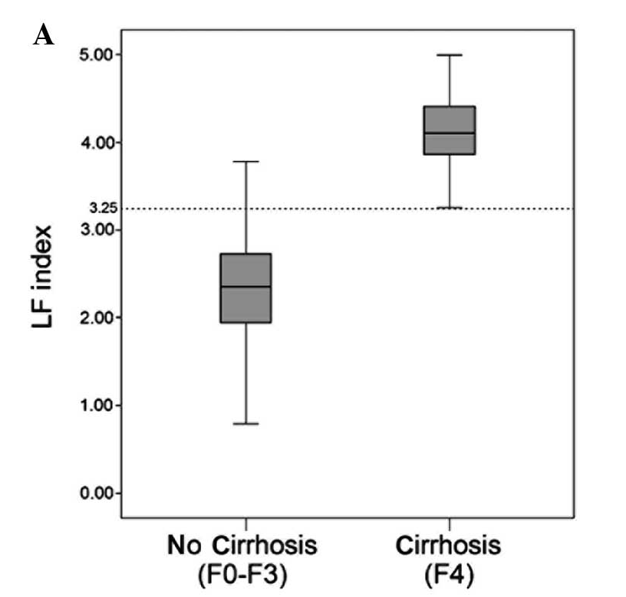
The ROC curve
Inidividual patients plot
Box plot

Slide 26
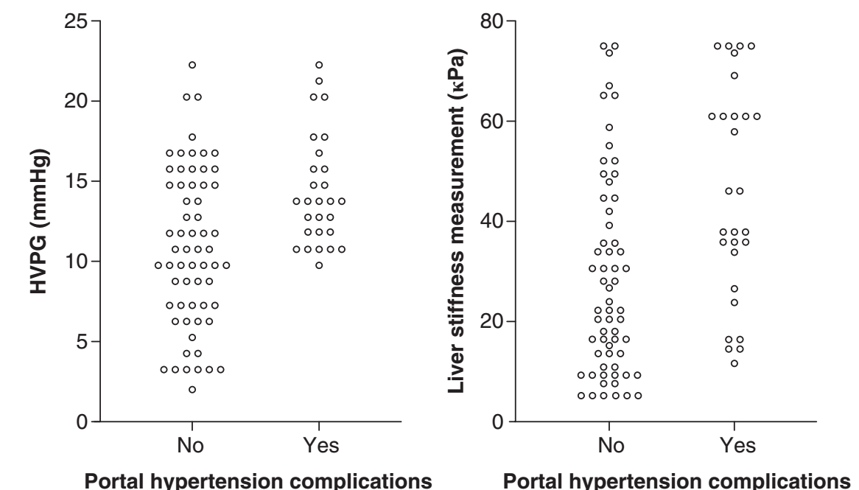
The ROC curve
HVPG vs LS for a Target Condition: which of the two has the higher AUC?

Slide 27
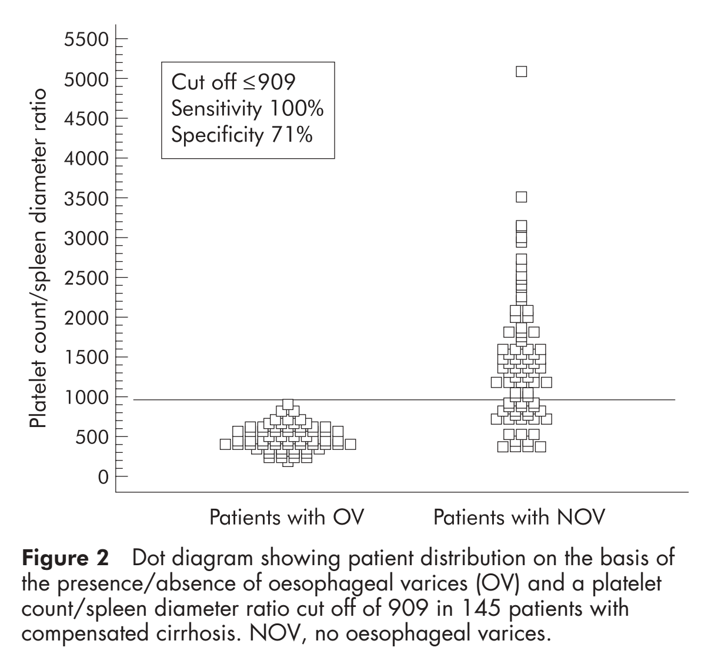
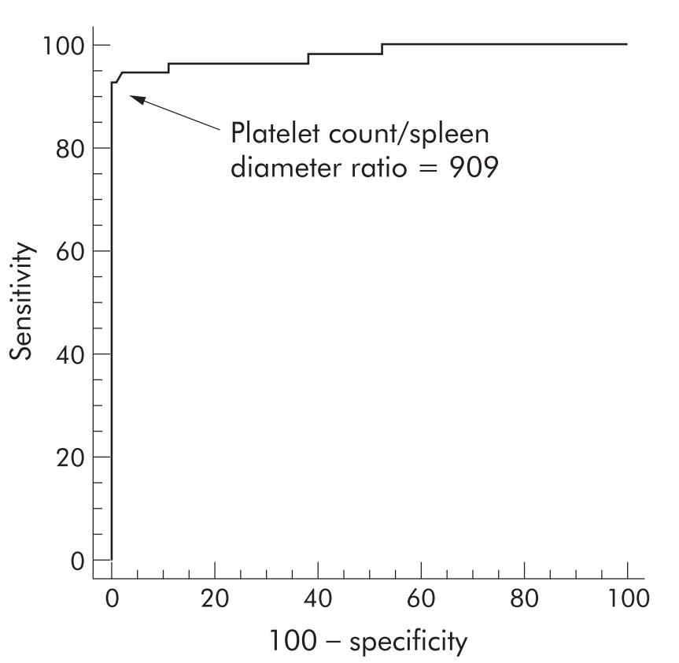
The ROC curve
Platelet count/spleen diameter ratio: proposal and validation of a non-invasive parameter to predict the presence of oesophageal varices in patients with liver cirrhosis Gut 2003;52:1200–1205

Slide 28
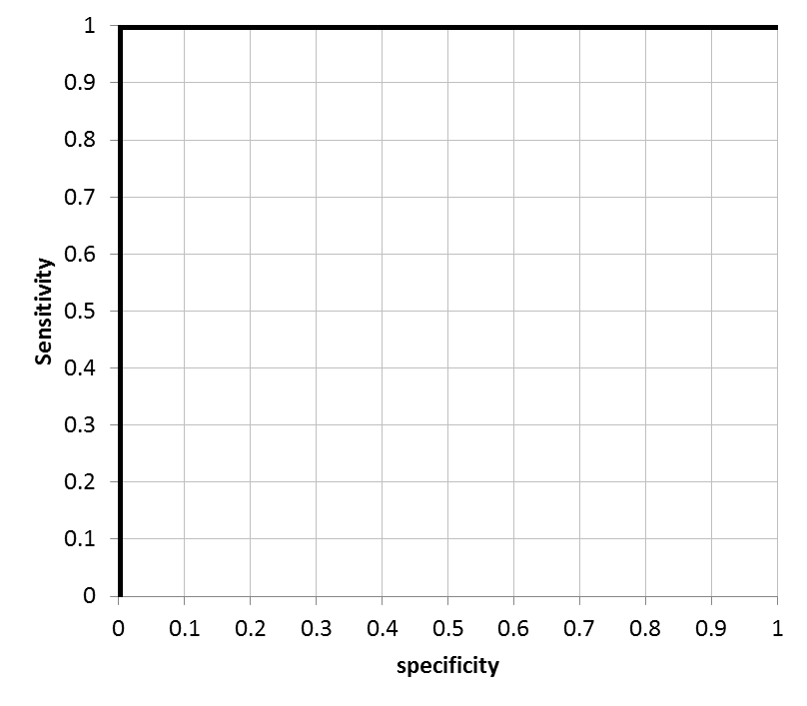
The ROC curve
The perfect test: sensitivity and specificity both 100%.
1.0 0.9 0.8 0.7 0.6 0.5 0.4 0.3 0.2 0.1 0

Slide 29
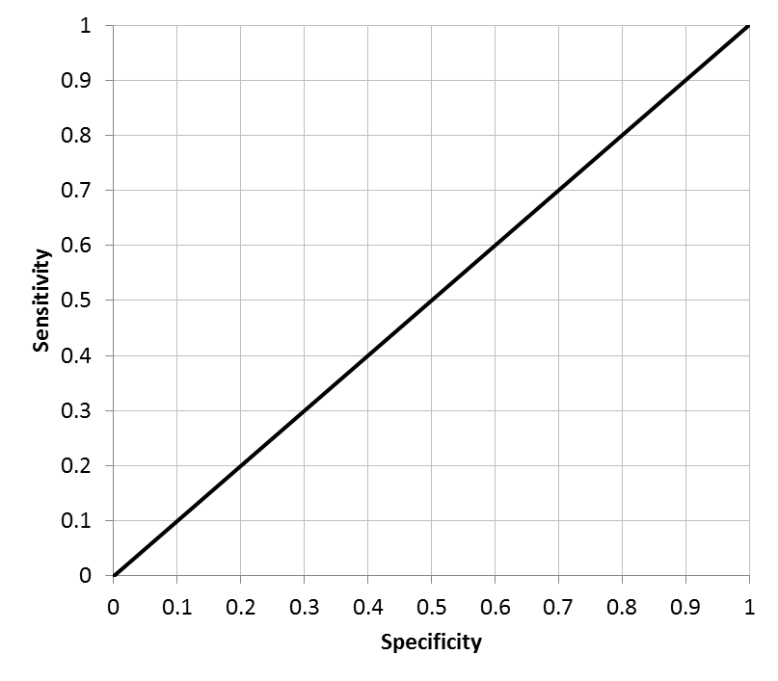
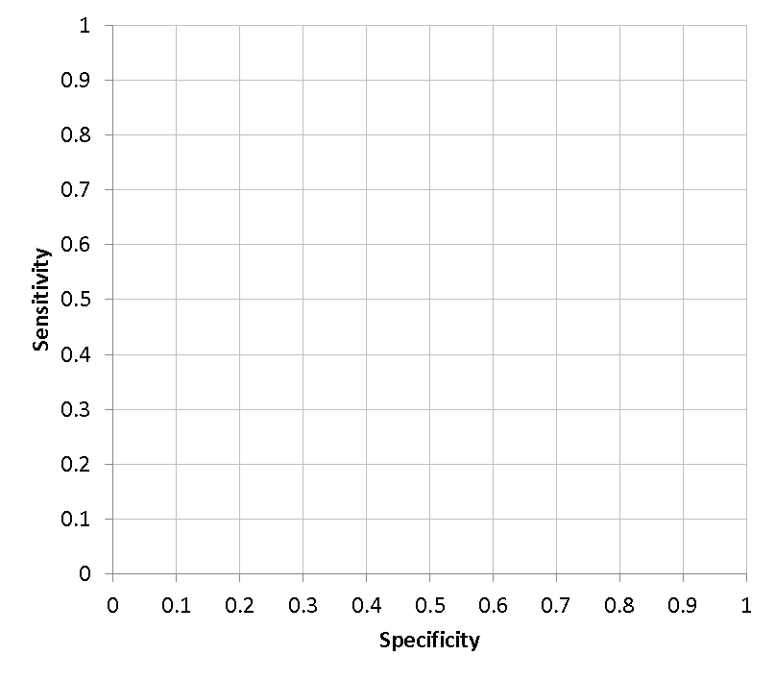

The ROC curve
A new index test with sensitivity 99% and specificity 1%.
Is that test useful for … … ?
The worthless test … like flipping a coin.
What is the value of LRs?
0.99
LR+=1 for each point of the curve
LR -=1 for each point of the curve
0.01
1.0 0.9 0.8 0.7 0.6 0.5 0.4 0.3 0.2 0.1 0

Slide 30
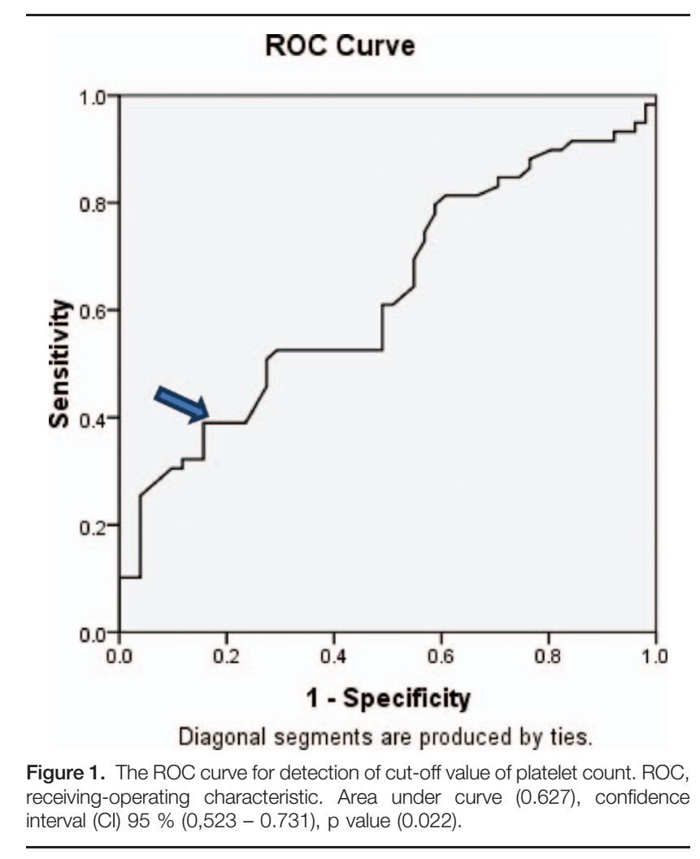
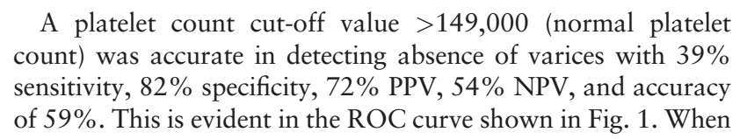
The ROC curve
Correlation of platelets count with endoscopic findings in a cohort of Egyptian patients with liver cirrhosis Medicine (2016) 95:23
Reading the results of a study

Slide 31
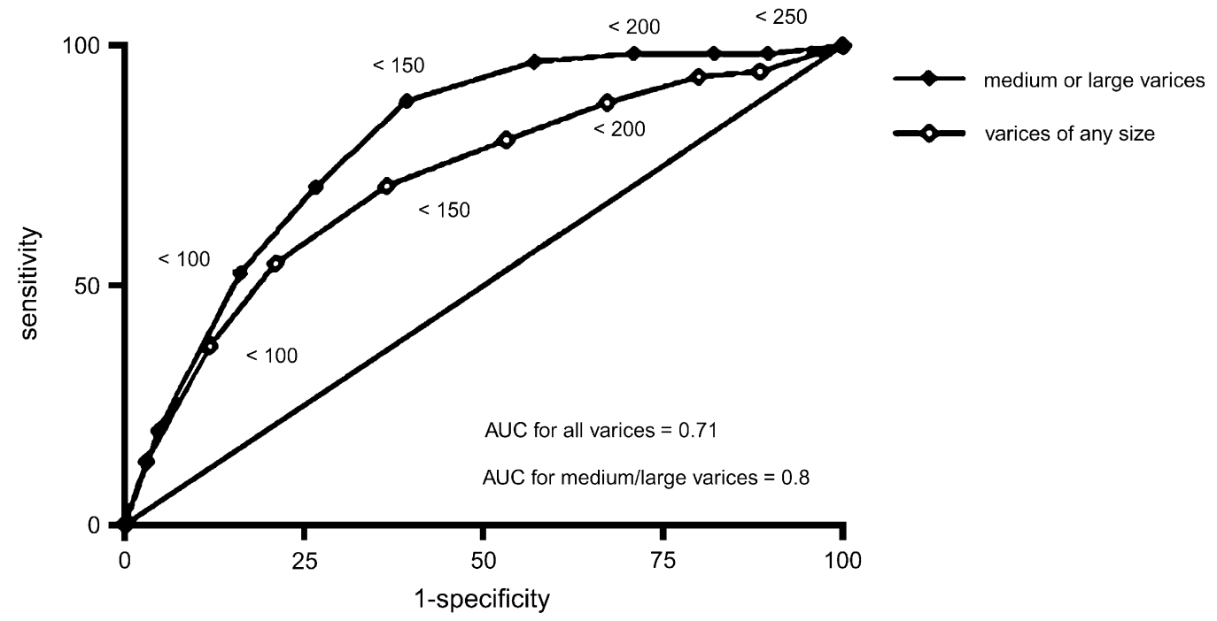
The ROC curve
Reading a ROC curve
Choosing the cut-off value

Slide 32
Take home points
The ROC curve as a summary of the pairs (sensitivity, specificity) at each cut-off.
Do not give too much importance to the value of AUC: “read” the whole curve.
Assess if the test is (and how much is) useful to rule-in or to rule-out the target condition.
AUC may be useful to compare the overall accuracy of two or more tests

