Slide 1
EVIDENCE-BASED TREATMENT –
the pathway out of the bed
and back to life!
GARGNANO April 2017
Christian Gluud
The Copenhagen Trial Unit
Denmark

Slide 2
Outline
What does evidence–based treatment mean?
Waste in clinical research
Lack of proper education
How to get EBM into practise

Slide 3
Outline
What does evidence–based treatment mean?
Waste in clinical research
Lack of proper education
How to get EBM into practise

Slide 4
The evidence hierachy

Slide 5
Evidence-based medicine
is the
judicious integration of
- the best external evidence with
- the patient’s wishes and with
the experiences of the health-care
workers

Slide 6
‘Personalised medicine’
RUBBISH AND MISNOMER – 5000 years TCM
Stratified medicine (prognostic markers)
Targeted medicine (HER2 recptor positive)
Medication adjusted to the patient’s
responces

Slide 7
Outline
What does evidence–based treatment mean?
Waste in clinical research
Lack of proper education
How to get EBM into practise

Slide 8
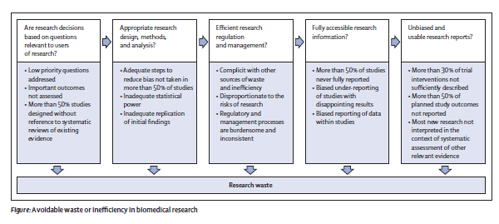
Waste in clinical research – The Lancet
At least 85% of clinical research is waste!
Annually about $170 billion is wasted!

Slide 9
Waste in clinical research
from lack og publication
(publication bias)
from lack of methodological rigor in what is published
(lots of other biases)

Slide 10
Outline
What does lack of transparency mean for clinical practice?
- What are the problems?
- Why does this affect clinical
practice?
- Industries fights against
- Physicians are the culprit
- The future may become better

Slide 11
The problems are
Only about every second trial is reported
Most reported trials are those with positive findings
Harms are ignored
Impossible to obtain deidentified individual patient data

Slide 12
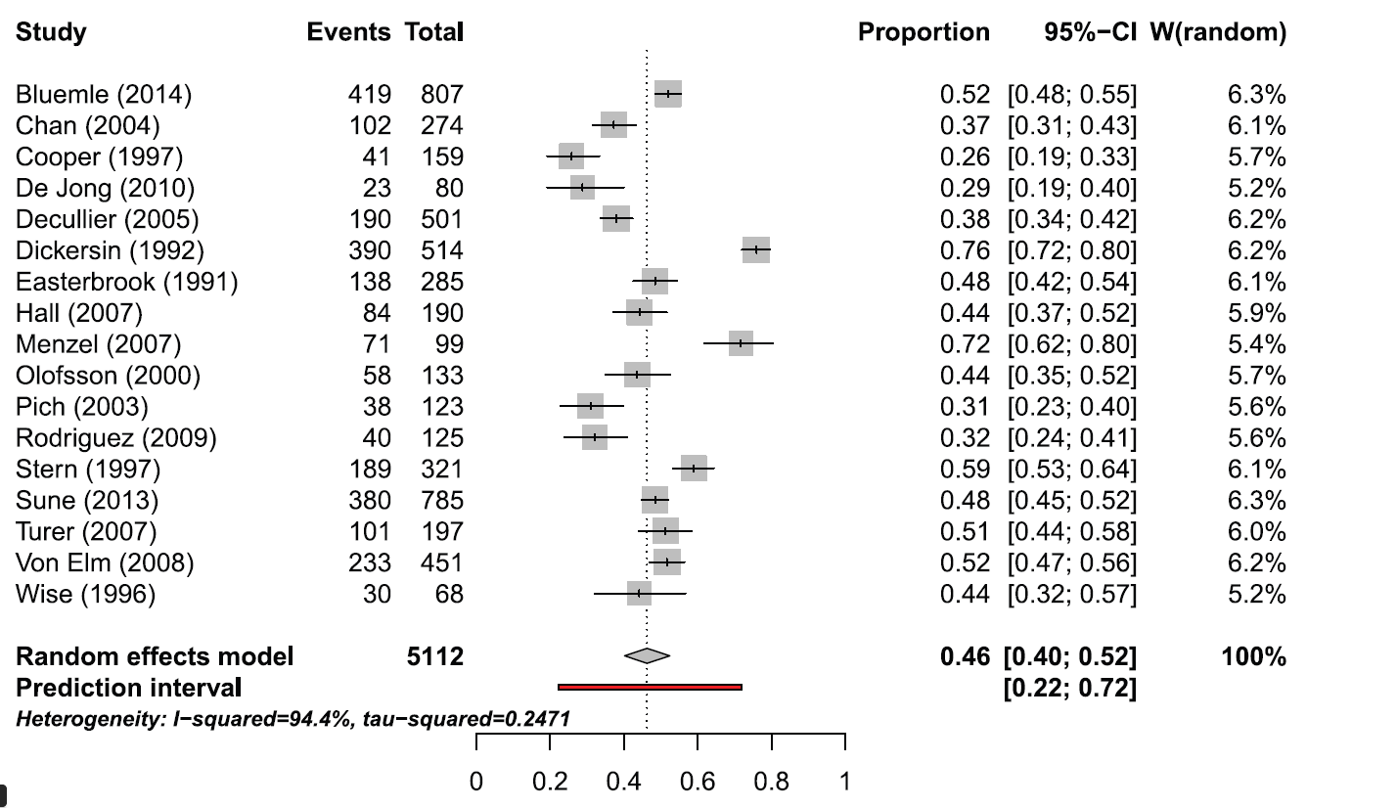
Weighted proportion of non-published trials from ethics committees or registeries – Schmuker 2015 PLoS ONE

Slide 13
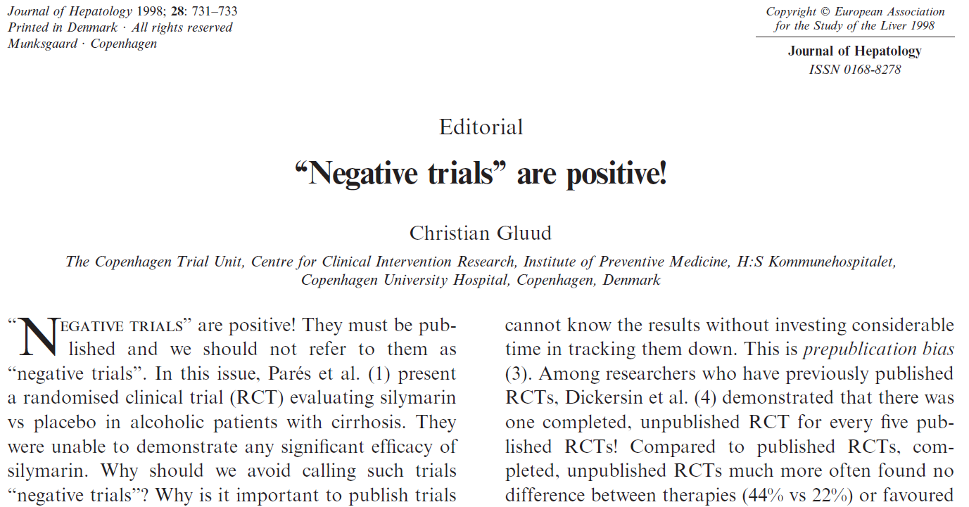

Slide 14
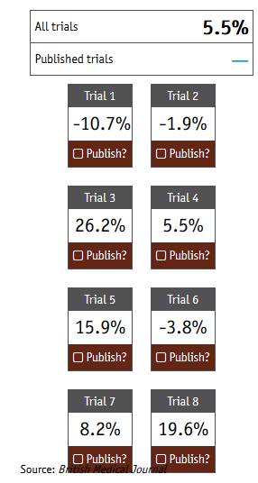
T
The Economist’s clinical trial publication game – drug x versus placebo

Slide 15
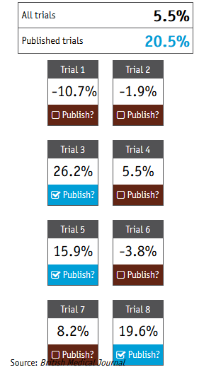
The Economist’s clinical trial publication game –
drug x versus placebo

Slide 16
The Economist’s clinical trial publication game –
drug x versus placebo
.......is this game really what it takes to
become a succesful drug or device
industry CEO????????

Slide 17
No access to depersonalised individual data
No chance to check the analyses
No chance to learn from data not reported
No chance to conduct individual patient
data meta-analyses
Against the whole idea of conducting
clinical research
Against agreed by informed consent

Slide 18
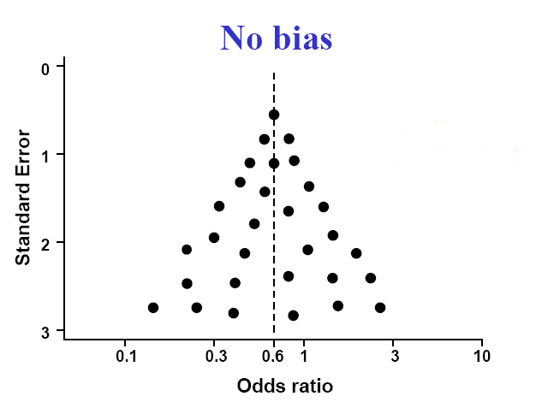
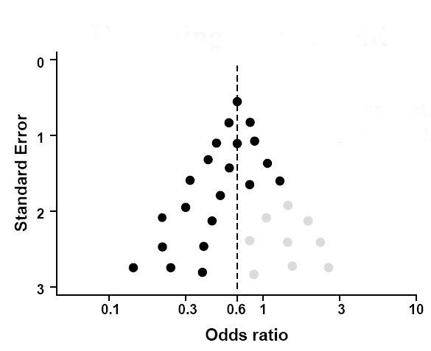
The dire consequences of publication bias
for clinical practice
PUBLICATION BIAS

Slide 19
COMPARE study
Tracking switched outcomes
in clinical trials – top five journals 2015/2016
67 trials checked - 9 trials were perfect!
86% NOT PERFECT
- 354 outcomes not reported
- 357 new outcomes silently added
On average, only 58.2% of specified outcomes reported!!!!!!!!!!!!
On average, each trial silently added 5.3 new outcomes!!!!!!!!!!

Slide 20

The industry fights aginst transparency
EFPIA and PhRMA ”our proprietary
rights”
Large number of ‘cases’ of deception

Slide 21
Physicians are the culprits
Accepts trials without proper data sharing plan in ethics review boards/committees
Signs non-publication agreements with
industry or themselves
Do not know the data or the analyses

Slide 22
International initiatives promoting transparency of clinical research
The Ottawa Group
The Cochrane Collaboration
The U.K. Medical Research Council
The U.S. National Institutes of Health
The Public Library of Science,
BMJ, and now also the ICMJE
The Nordic Trial Alliance report
AllTrials campaign
The WHO

Slide 23
But where are you?

Slide 24
How can data become shared
transparently?
Anonymised IPD
Depersonalised IPD
Looks fully alike in the data bank,
however,
a securely kept key can personalise
the latter!

Slide 25
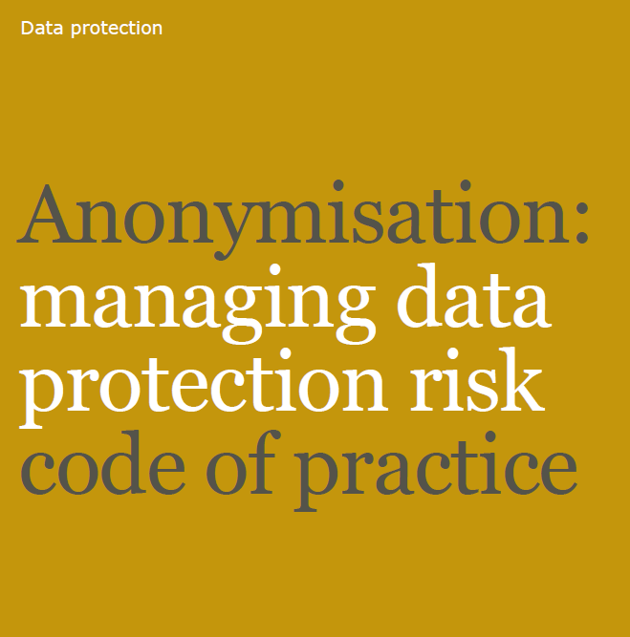


Slide 26
Outline
What does transparency mean for
clinical practice?
Waste of research
Lack of proper education
How to get EBM into practise

Slide 27
The evidence hierachy

Slide 28
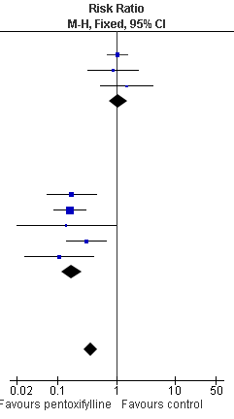
Meta-analysis of several trials
Low risk of bias
High risk of bias
Overall

Slide 29
Ratio of odds ratios (ROR)
Odds ratio of trials with inadequate or unclear
component (high risk of bias)
divided by
odds ratio of trials with adequate
component (low risk of bias)

Slide 30
Components associated with bias risk
Generation of the allocation sequence
Allocation concealment
Blinding
Incomplete outcome data (intention-to-treat)
Outcome measure reporting bias
Other components associated with bias (vested interest bias and industry bias)

Slide 31
Systematic errors (bias) in randomised trials depends on
the methodological quality, ie,
the confidence that the design, conduct, and report of a trial restrict bias in the intervention comparison
Notes:
It is generally believed that intervention comparisons may be misleading if the groups to be compared are in some way systematically different regarding for example known and unknown prognostic factors or treatment regimens.
Accordingly the methodological quality of clincial trials can be described as the confidence .....

Slide 32
Bias risks in more than 95% of
randomised trials
Methodological quality regarding
generation of the allocation sequence
allocation concealment
blinding
intention-to-treat analysis
is inadequate in > 95% of trials and
associated with overestimation of
benefits and underestimation of harms

Slide 33
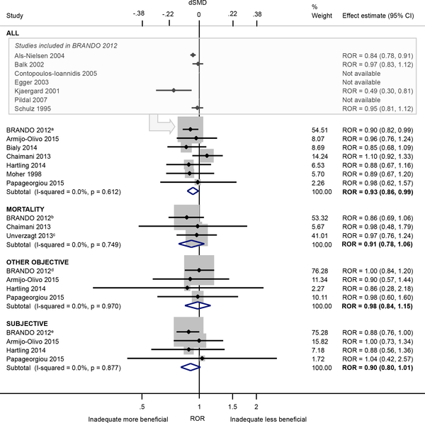
RORs associated with inadequate/unclear compared to adequate sequence generation
Page et al. PLoS ONE 2016

Slide 34
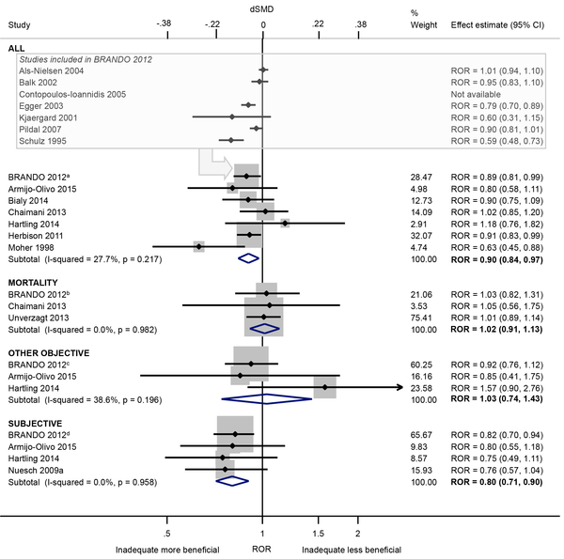
RORs associated with inadequate/unclear compared to adequate allocation concealment
Page et al., PLoS ONE 2016

Slide 35
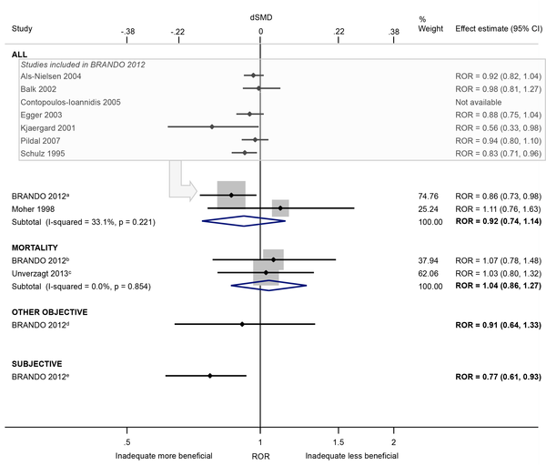
RORs associated with lack of/unclear double blinding compared to double blinding
Page et al, PLoS ONE 2016

Slide 36
Association between industry funded trials and methodological quality
Proportion of 616 randomised trials
(Kjaergard & Gluud 2002)

Slide 37

Huge imbalance of industry-funded
and public-funded clinical research
Industry-funded clinical research compared to public-funded clinical research is skewed 80:20

Slide 38
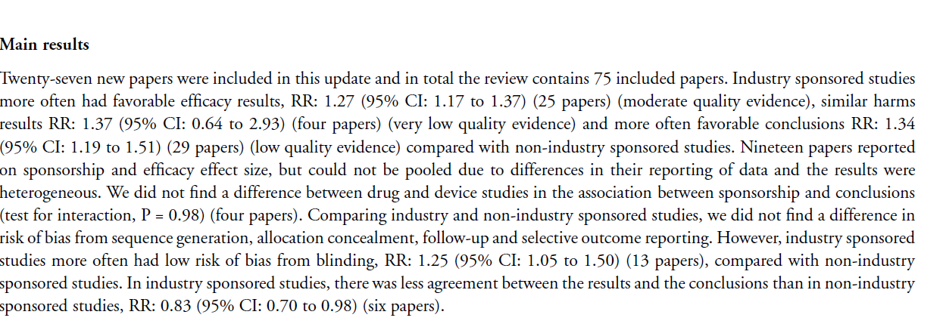
What does industry funding mean?
Lundh et al, Cochrane Library 2017

Slide 39
What does industry funding mean?
Lundh et al, Cochrane Library 2017
More often favorable efficacy results
RR 1.27 (95% CI 1.17 to 1.37)
More often favorable conclusions
RR 1.34 (95% CI 1.19 to 1.51)

Slide 40
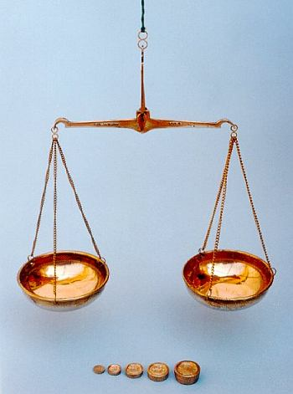
Unfair test - randomised clinical trial
Experimental intervention
- random errors (PUB bias)
- systematic errors (bias)
- selective reporting (OM bias)
Control intervention
“…....why most research findings are false!” JP Ioannidis

Slide 41
Trial Sequential Analysis
Plethora of random type I and type II errors in systematic reviews and meta-analyses!
Ought to be controlled with Trial Sequential Analysis!

Slide 42
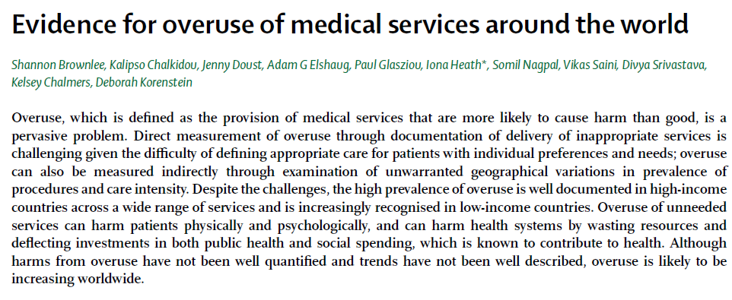
Evidence of overuse of treatments -
The Lancet 2017

Slide 43
Some few examples of harmful overuse:
Antibiotics
Antidepressants (SSRIs)
Knee replacements
Hysterectomies
Vitamin D tests
Endoscopies
Percutaneous coronary interventions
............and they increase in both high,
Middle and low income cuntries.........

Slide 44
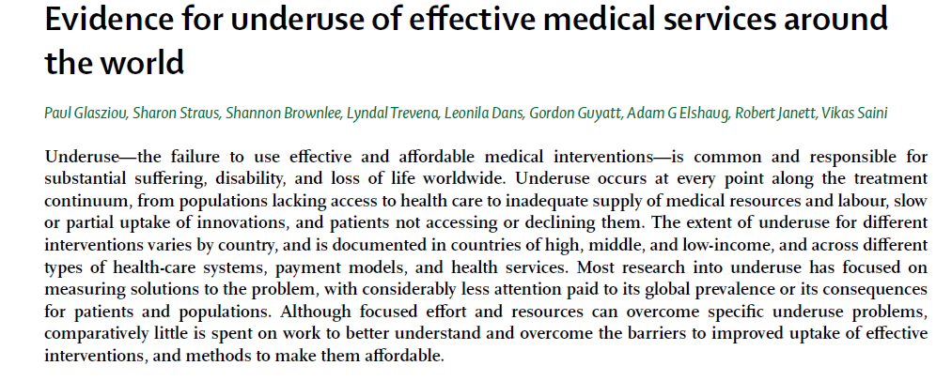
Evidence of underuse of treatments –
The Lancet 2017

Slide 45
Some few examples of harmful underuse:
Financial barriers
Lack of staff
Lack of education
Glucocorticosteroids for preterm labour
Anticoagulation for atrial fibrillation

Slide 46
Thank you !

Slide 47


Slide 48


Slide 49
