Slide 1

The Cochrane systematic REVIEW of diagnostic test accuracy (DTA)

Slide 2
OUTLINE
(THE) COCHRANE (COLLABORATION)
THE COCHRANE LIBRARY
RESEARCH QUESTION:
- TITLE FORMULATION AND REGISTRATION
PROTOCOL DEVELOPMENT AND PUBLICATION
REVIEW DEVELOPMENT AND PUBLICATION
UPDATES

Slide 3

WWW. COCHRANE.ORG
COCHRANE
(THE COCHRANE COLLABORATION)

Slide 4
Cochrane Groups
  Cochrane Review Groups (CRGs)
    the preparation and maintenance of systematic reviews;
    each focused on a specific topic of health research.
  Cochrane Centres
    support Cochrane contributors in their area.
  Cochrane Fields
    focus on health care (e.g. primary care), type of consumer (children, older people) or provider (nursing).
  Cochrane Methods Groups
    provide policy advice, and discuss development and implementation of methods used in the preparation of Cochrane Reviews.

Slide 5
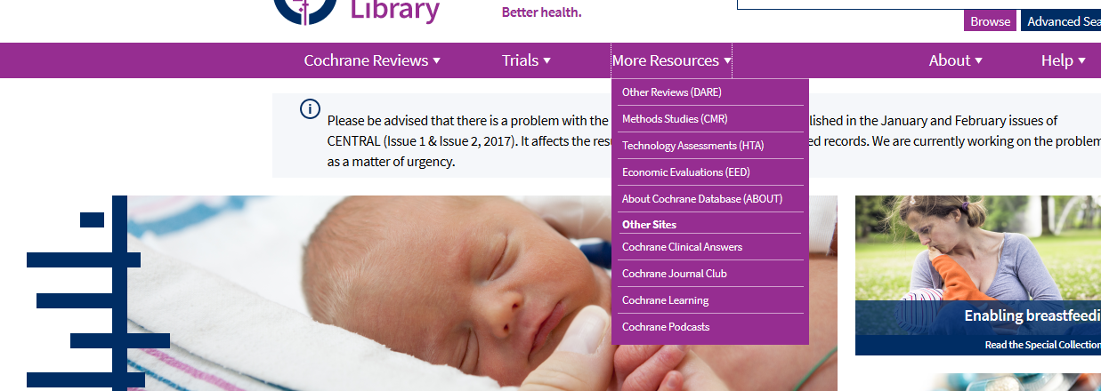
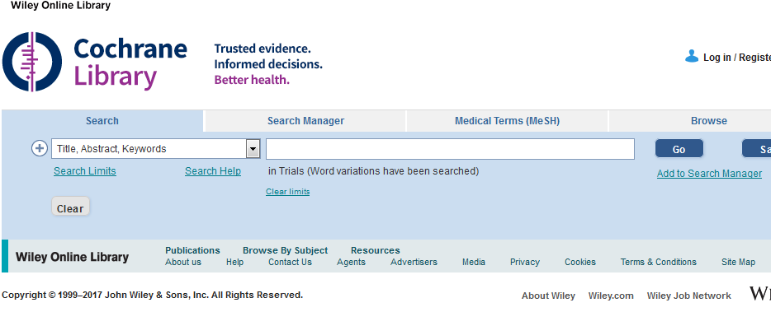

Slide 6

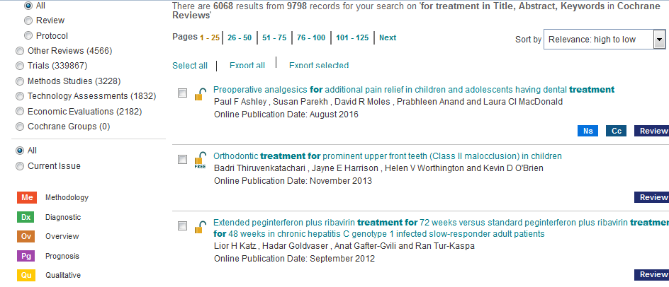
INTERVENTION REVIEWS

Slide 7

http://www.cochrane.org/what-is-cochrane-evidence
What is Cochrane evidence and how can it help you?

Slide 8

UNDERTAKING COCHRANE DTA REVIEW
STEPS OF DTA REVIEW
- IDENTIFY THE RELEVANT REVIEW GROUP
- SEND A COMPLETED REVIEW PROPOSAL FORM
- ONCE ACCEPTED, PROCEED AS PLANNED

Slide 9

  DEFINE THE RESEARCH QUESTION AND ITS SUITABILITY
    IS THE TEST USABLE IN THE DIAGNOSTIC PATHWAY
    DEFINE OBJECTIVES (INCLUSION CRITERIA)
    PREPARE AND PUBLISH PROTOCOL

Slide 10
PROCEED TO REVIEW
SEARCH AND SELECT STUDIES
COLLECT DATA
ASSESS BIAS AND APPLICABILITY
ANALYSE AND PRESENT RESULTS
INTERPRET RESULTS AND DRAW CONCLUSIONS
IMPROVE, UPDATE, AND PUBLISH THE REVIEW

Slide 11
WHY IS TITLE FORMULATION (RESEARCH QUESTION) CRUCIAL FOR A DTA REVIEW?

Slide 12
INFORMATIVE TITLE FACILITATES
DISSEMINATION
- THE INDEX TEST EVALUATED AND COMPARED WITH
  - THE TARGET CONDITION
- TYPE OF PARTICIPANTS

Slide 13
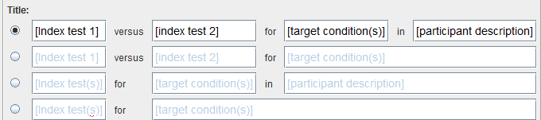
TITLE FORMULATION
What is the diagnostic accuracy of ‘index test’ for diagnosing ‘target condition’ in ‘patient description’?

Slide 14
INDEX TEST
”A diagnostic test that is being evaluated against a reference standard test in a study of test accuracy”
REFERENCE STANDARD
“The test, combination of tests, or procedure that is considered the best available method of categorising participants in a study of DTA as having or not having a target condition”
TARGET CONDITION(S)

Slide 15
TARGET CONDITION(s)
THE CONDITION WE WANT THE INDEX TEST(S) TO DETECT
IT WILL DETERMINE THE APPROPRIATE REFERENCE STANDARD
MORE THAN ONE REFERENCE STANDARD MAY BE CONSIDERED APPROPRIATE

Slide 16
COMPONENTS OF A DTA TITLE/REVIEW QUESTION
PARTICIPANTS
PRESENTATION
PRIOR TEST(S) (WILL DEPEND ON THE SETTINGS)
INDEX TEST
PURPOSE (to replace; triage; add-on)
TARGET CONDITION(S)

Slide 17
COMPARATOR TESTS
REFERENCE STANDARD
…COMPONENTS OF A DTA REVIEW TITLE/
REVIEW QUESTION

Slide 18
INDEX TEST
MAY BE NEW OR ALREADY USED IN CLINICAL PRACTICE
HOW DOES IT PERFORM IN COMPARISON WITH (AN)OTHER TEST(S)
COMPARISON OF THRESHOLDS

Slide 19
PURPOSE OF THE INDEX TESTS
REPLACEMENT?
ADD-ON?
TRIAGE?

Slide 20

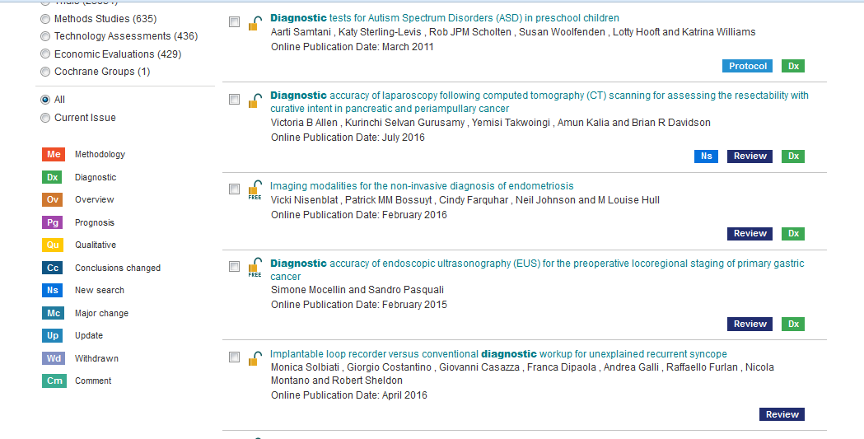
DIAGNOSTIC TEST ACCURACY REVIEWS

Slide 21
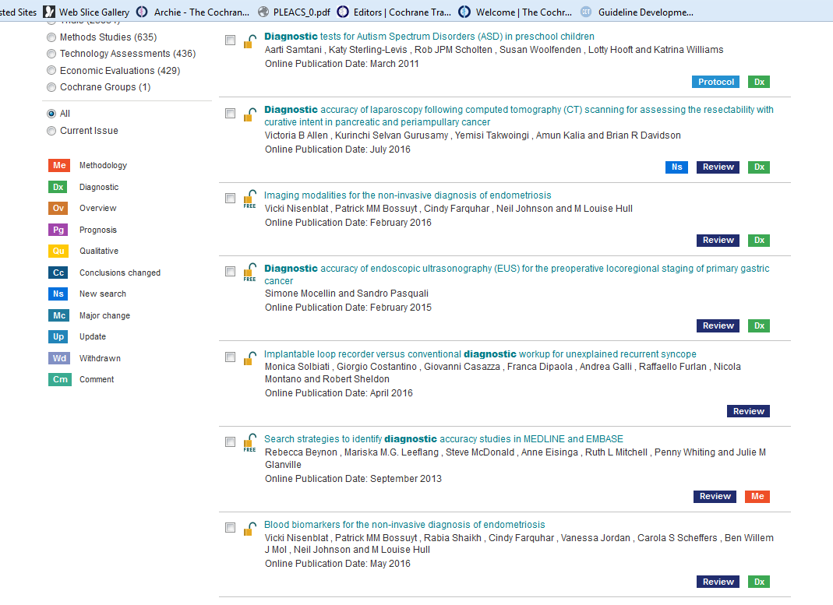

Slide 22
INTERVENTION REVIEWS HAVE DIRECT IMPACT ON
PATIENT-ORIENTED OUTCOMES
DTA REVIEWS SELDOM HAVE; DTA REVIEWS PROVIDE
DECISIONS WHICH PATIENT TO TREAT AND
WHICH NOT TO TREAT

Slide 23
Dta review title and protocol development
Cochrane Handbook for Systematic Reviews of Diagnostic Test Accuracy
http://methods.cochrane.org/sdt/handbook-dta-reviews

Slide 24
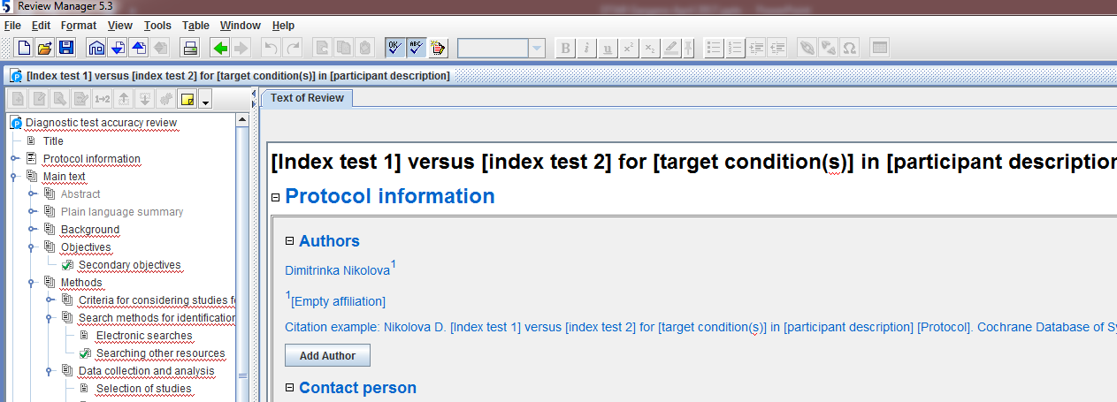

Slide 25
THE COCHRANE DTA REVIEW PROTOCOL
STANDARD FORMAT!
BACKGROUND (Why is this review important? key clinical issues?)
TARGET CONDITION BEING DIAGNOSED (frequency, severity, prognosis, possible treatment)

Slide 26
THE COCHRANE DTA REVIEW PROTOCOL
STANDARD FORMAT!
BACKGROUND
……
INDEX TEST (details in any test variation, manufactureres, how many thresholds will be considered)
CLINICAL PATHWAY (the existing pathway)

Slide 27
….. THE COCHRANE DTA REVIEW PROTOCOL
PRIOR TESTS (yes or no)
ROLE OF INDEX TESTS (in the pathway)
ALTERNATIVE TESTS (used but will not be evaluated in your review)
RATIONALE (why is the review needed?)

Slide 28
oBJECTIVES
- ESTIMATE ACCURACY OF A TEST (AT A PARTICULAR THRESHOLD)
- MAKE COMPARISONS BETWEEN TESTS CONCERNING THIER ACCURACY
- UNDERSTAND WHY RESULTS OF STUDIES VARY

Slide 29
OBJECTIVES
  PRIMARY
  To determine the dianostic accuracy of [index test] for detecting …….
  To estimate the test accuracy for each test at pre-specified thresholds
  SECONDARY
  ..Related to the investigation of heterogeneity between study results
  that may be due to different study design; sample size; clinical setting;
  spectrum of the disease; cut-off points etc

Slide 30
METHODS
CRITERIA FOR CONSIDERING STUDIES FOR THIS REVIEW
TYPES OF STUDIES (cross-sectional study) prospective, retrospective, or both?;
how and where participants were recruited: as a consecutive series in
primary care?.. State restrictions!
PARTICIPANTS (for whom the test would be applicable; sex, age, settings)
State restrictions!
INDEX TESTS (the tests to be evaluated; single or multiple tests; provide
details for each test)

Slide 31
METHODS
…CRITERIA FOR CONSIDERING STUDIES FOR THIS REVIEW
TARGET CONDITIONS (the target desease or disease stage the index test
is going to detect;
or
the ability of the test to differentiate between several target conditions (if so, list these)
REFERENCE STANDARDS
(one or more? Are all applicable or not? State exclusion criteria!)

Slide 32
SEARCH METHODS FOR IDENTIFICATION
OF STUDIES
ELECTRONIC SEARCHES
SEARCHING OTHER RESOURCES
DESIGN SEARCH STRATEGIES.
REMEMBER DTA STUDIES ARE POORLY INDEXED.
MINIMUM TO INCLUDE: TARGET CONDITION AND INDEX TEST(S)

Slide 33
MEDLINE | 1990 to the date of search. | # 1 'nuclear magnetic resonance imaging': ab,ti # 2 'nuclear magnetic resonance imaging'/exp # 3 'magnetization transfer imaging':ab,ti # 4 mrcp: ab,ti OR mri: ab,ti OR nmr: ab,ti AND imaging: ab,ti OR fmri: ab,ti # 5 mrcp:ab,ti OR mri:ab,ti OR 'nmr imaging':ab,ti OR fmri:ab,ti # 6 cholangiopancreatograph*: ab,ti #7 #1 OR #2 OR #3 OR #4 OR #5 #8 #6 OR #7 #9 'digestive system diseases'/exp #10 'biliary tract': ab,ti #11 'bile duct':ab,ti #12 'biliary duct':ab,ti #13 'jaundice':ab,ti #14 'stenosi':ab,ti OR 'strictur':ab,ti OR 'narrow':ab,ti OR 'explore':ab,ti OR 'exploration':ab,ti #15 'biliary stricture':ab,ti #16 #10 OR #11 OR #12 #17 #14 AND #16 #18 #13 OR #15 OR #17 #19 #9 OR #18 #20 #8 AND #19
Combination of
magnetic resonance cholangiopancreatography
and
conventional magnetic resonance imaging
for the diagnosis of
bile duct stenosis

Slide 34
DATA COLLECTION AND ANALYSIS
SELECTION OF STUDIES
DATA EXTRACTION AND MANAGEMENT
PAIRED OUTCOMES:
SENSITIVITIES (SE) AND SPECIFICITES (SP)
RECEIVER OPERATING CHARACTERISTIC CURVE (ROC)
The truth (reference standard)
 |  | With disease | Without disease
Test | + | TP (no of pts) | FP (no of pts)
 | - | FN (no of pts) | TN (no of pts)
 | Total | (no of pts) | (no of pts)
SE
SP

Slide 35
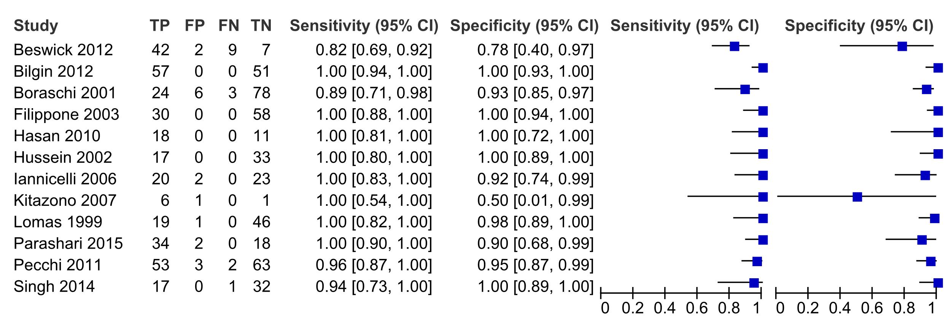

Slide 36
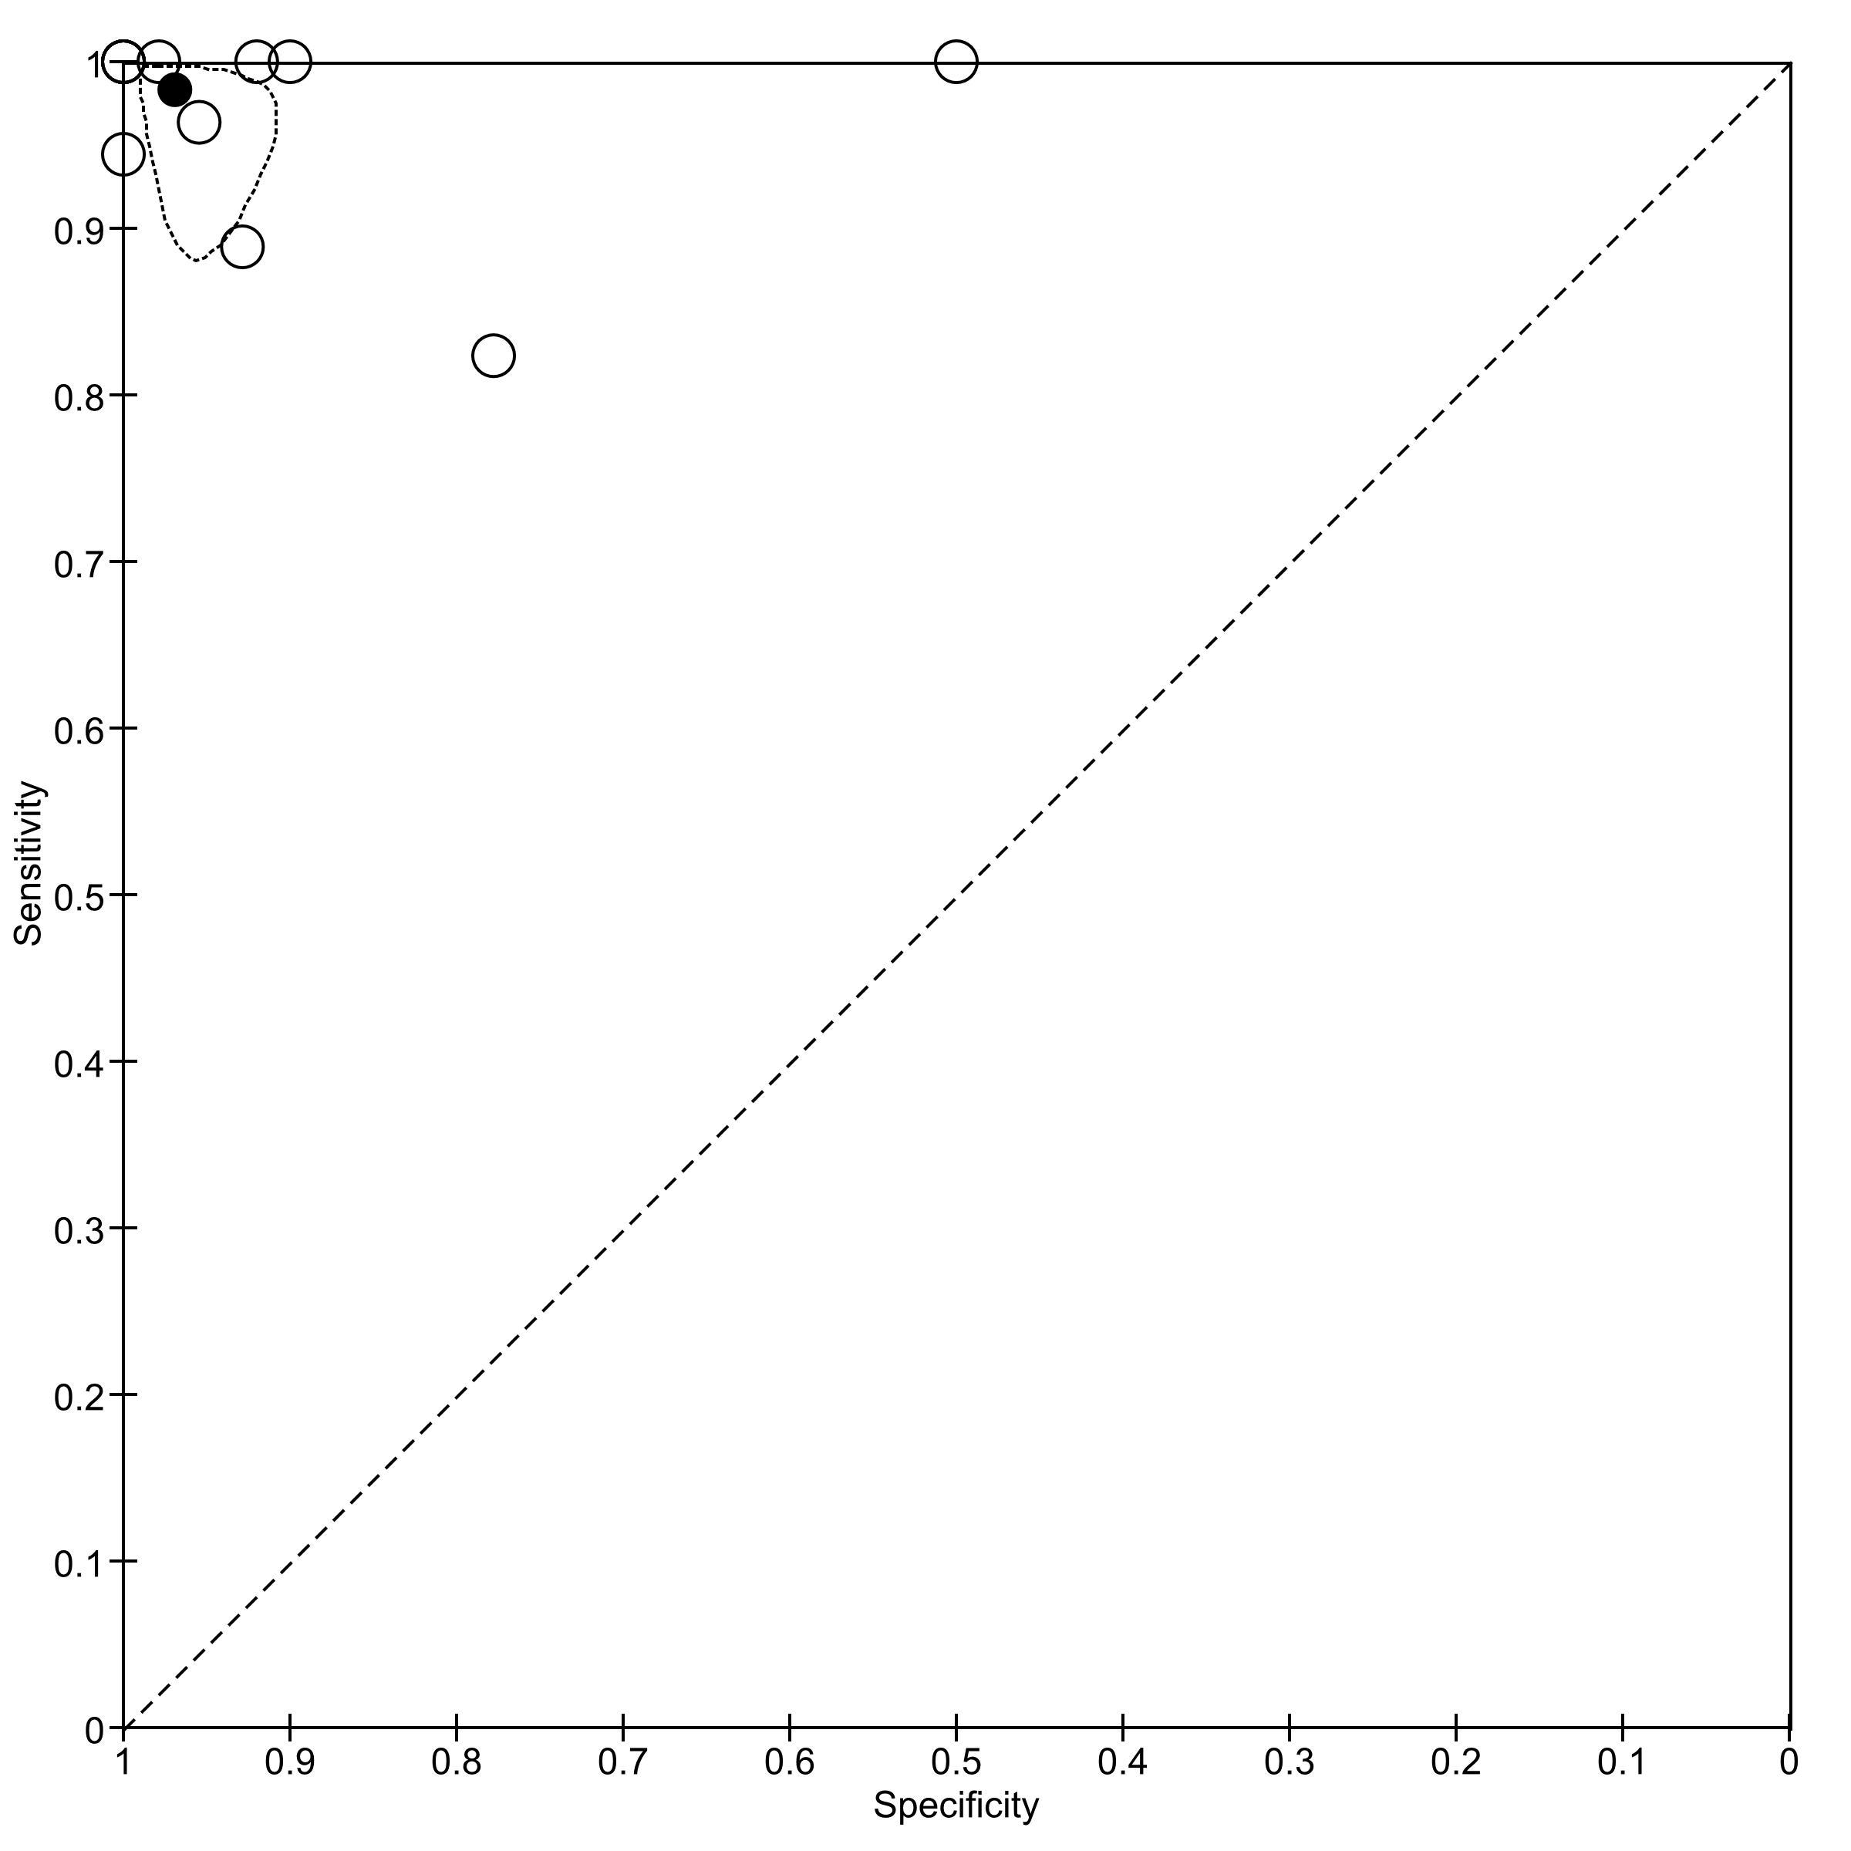
SROC PLOT

Slide 37
..DATA COLLECTION AND ANALYSIS
.SELECTION OF STUDIES
…DATA EXTRACTION AND MANAGEMENT
……………..
HETEROGENEITY IS EXPECTED
STUDY DESIGN
ISSUES OF BIAS
RANDOM-EFFECTS BY DEFAULT
YOU NEED EXTERNAL SOFTWARE AND A STATISTICIAN!

Slide 38
……..DATA COLLECTION AND ANALYSIS
ASSESSMENT OF METHODOLOGICAL QUALITY
(QUADAS 2)
Domain Participant selection Index test Reference standard Flow and timing
Signalling questions 3 questions 2 q 2 q 4 q and criteria Yes, no, or unclear
Bias risk Selection of participants; index test(s); reference standard; participants’ flow
High, low, unclear
Concerns about Do they match the Does it differ Does the target condi- applicability review question from the tion as defined by the review reference standard question match the review question
High, low, unclear

Slide 39
SENSITIVITY ANALYSES
We will perform sensitivity analyses by considering only cross-sectional design studies (i.e., excluding case-control studies), and studies assessed as low risk of bias
ASSESSMENT OF REPORTING (PUBLICATION) BIAS
(write about existing tests for reporting bias)
ACKNOWLEDGEMENTS
CONTRIBUTION OF AUTHORS
DECLARATIONS OF INTEREST
PUBLISHED NOTES

Slide 40
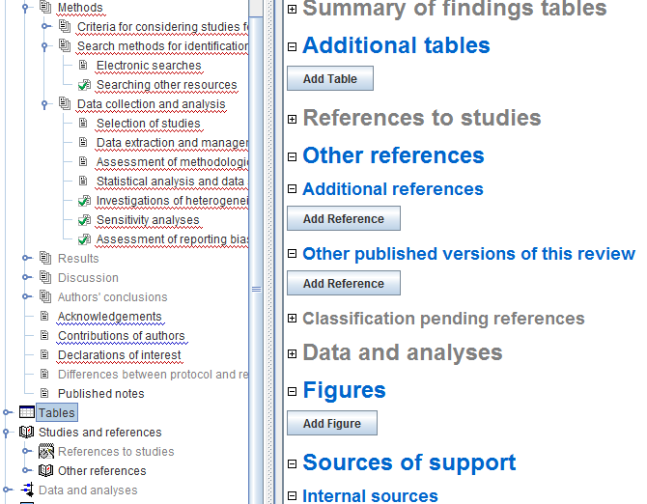

Slide 41
SO, WHY A PROTOCOL?
ENSURES THAT THE RESEARCH QUESTION
HAS BEEN WELL-THOUGHT THROUGH
ENSURES THE METHODOLOGY THROUGH
PRESPECIFICATION OF METHODS - REDUCES BIAS
PEER-REVIEWED BEFORE PUBLICATION

Slide 42
SO, WHY A PROTOCOL?
REDUCES THE RISK OF DUPLICATION OF EFFORT

Slide 43
THANK YOU!

Slide 44
Transient elastography for diagnosis of stages of
hepatic fibrosis and cirrhosis in people with
alcoholic liver disease
Objective
To determine the diagnostic accuracy of transient elastography
for diagnosis and staging hepatic fibrosis in people with
alcoholic liver disease when compared with liver biopsy.
In addition, to identify the optimal cut-off values for differentiating the five
stages of hepatic fibrosis.
Pavlov CS, Casazza G, Nikolova D, Tsochatzis E, Burroughs AK, Ivashkin VT, Gluud C. Transient elastography for diagnosis of
stages of hepatic fibrosis and cirrhosis in people with alcoholic liver disease. Cochrane Database of Systematic Reviews 2015,
Issue 1. Art. No.: CD010542. DOI: 10.1002/14651858.CD010542.pub2.

Slide 45
Index tests
Transient elastography, a non-invasive test, measuring liver stiffness in kiloPascals (kPa).
  Describe recommended technical parameters assumed to ensure the validity of
the transient elastography result for every participant in the single studies…
What types of participants will you consider data from? (e.g. the full set of the data that
we have described)
Is the test recommended for all?
What are the factors that may influence the success of transient elastography
investigation? ( e.g. experience of the operator and body mass index of the person.
Liver stiffness measurement depending on the grade of necro-inflammation and
grade of steatosis.. etc)

Slide 46
Target conditions
The presence of hepatic fibrosis in people with alcoholic liver disease.
Based on the METAVIR histopathological score for interpreting
liver biopsy, there are five stages of hepatic fibrosis (Table
1).
• F0: no fibrosis.
• F1: mild fibrosis.
• F2: significant fibrosis.
• F3: severe fibrosis.
• F4: cirrhosis.
We dichotomised the hepatic fibrosis estimated by the METAVIR
score as follows:
- people with METAVIR score of F1 or worse were considered ’diseased’ and people with METAVIR score of F0 are considered ’non-diseased’; etc

Slide 47
Participants
The studies have to include participants of any sex and ethnic origin, above 16 years old,
and diagnosed with alcoholic liver disease.
The participants could have been hospitalised or managed as outpatients.
The diagnosis of alcoholic liver disease in the study participants has to be established
based on registered history of excessive intake of alcohol of sufficient duration and quantity
together with clinical evidence of liver disease expressed with physical signs
at examination and followed by laboratory evidence of liver disease.
To ascertain the diagnosis of alcoholic liver disease and study the presence or
absence of hepatic fibrosis or cirrhosis, the studies had to perform both
transient elastography and liver biopsy.

Slide 48
Reference standards
Liver biopsy is the reference standard that is obtained by percutaneous
needle techniques, transjugular method, ultrasound-guided fine-needle, or surgical specimens (REF; REF).
Liver biopsy is the only existing reference standard so far for diagnosing
hepatic fibrosis stages in people with alcoholic liver disease.
Specimens of liver tissue with a mean length of at least 15mm and
at least seven portal tracts are among the factors that can provide
reliable morphological staging of hepatic fibrosis and grading of
inflammation (REF).
…
Describe what will you do if liver biopsy samples were reported with any of the semiquantitative scores, that is, METAVIR (REF), Knodell
(REF), Ishak (REF), etc.

Slide 49
Lateral flow urine lipoarabinomannan assay for detecting active tuberculosis in HIV-positive adults
Primary objectives
To assess the accuracy of LF-LAM for the diagnosis of active TB disease in HIV-positive adults who have signs and symptoms suggestive of TB (TB diagnosis).
To assess the accuracy of LF-LAM as a screening test for active TB disease in HIV-positive adults irrespective of signs and symptoms suggestive of TB (TB screening).
Shah M, Hanrahan C, Wang ZY, Dendukuri N, Lawn SD, Denkinger CM, Steingart KR. Lateral flow urine lipoarabinomannan assay for detecting active tuberculosis in HIV-positive adults. Cochrane Database of Systematic Reviews 2016, Issue 5. Art. No.: CD011420. DOI: 10.1002/14651858.CD011420.pub2.

Slide 50
Secondary objectives
To compare the diagnostic accuracy of LF-LAM and existing tests,
sputum smear microscopy or sputum Xpert® MTB/RIF, as well as
determine the diagnostic accuracy of LF-LAM when added to existing tests.
To investigate heterogeneity of test accuracy in the included studies.
Possible sources of heterogeneity include CD4 count and clinical setting (inpatient versus outpatient setting).

Slide 51
Index test(s)
The lateral flow urine lipoarabinomannan assay (LF-LAM)
is a commercially available point-of-care test for active
TB (Alere DetermineTM TB LAM Ag, Alere Inc, Waltham,
MA, USA).
The test detects lipoarabinomannan (LAM),
a lipopolysaccharide present in mycobacterial
cell walls, which is released from ….. and
appears to be present only in people with
active TB disease.

Slide 52
Reference standards
We will require studies to diagnose TB using at least one of the following two reference standards.
Microbiological reference standard:
  we define 'TB' as a positive M. tuberculosis culture or nucleic acid amplification test (NAAT);
  we define 'not TB' as a negative M. tuberculosis culture and NAAT (if performed).
Composite reference standard that includes M. tuberculosis culture together with at least one of the following components: NAAT, smear, or clinical findings:
  we define 'TB' as (1) a positive culture, or (2) a positive NAAT, or (3) a positive smear, or (4) a clinical decision to start TB treatment, and, after at least one month of follow-up, the participant was diagnosed as having TB;
  we define 'not TB' as a negative culture and NAAT (if performed), no TB treatment given, and resolution of signs and symptoms at follow-up.

Slide 53
Contrast-enhanced ultrasound (CEUS) compared with contrast-enhanced computed tomography (CECT), magnetic resonance imaging (MRI), and Fluro-18-deoxyglucose positron emission tomography-computed tomography (18F-FDG PET-CT) for diagnosing liver metastases in people with newly diagnosed colorectal cancer
OBJECTIVE:
To compare the accuracy of CEUS, CECT, MRI, and 18F-FDG PET-CT for diagnosing liver metastases in people with newly-diagnosed colorectal cancer.

Slide 54
Lund M, Bjerre TA, Grønbæk H, Mortensen F, Kragh Andersen P.
Contrast-enhanced ultrasound compared with computed tomogramphy, magnetic resonance imaging, and positron emission tomography for diagnosing liver metastases in people with newly diagnosed colorect al cancer.
Cochrane Database of Systematic Reviews
2016, Issue 10. Art. No.: CD012388. DOI: 10.1002/14651858.CD012388

Slide 55
Index tests
The index tests are CEUS, CECT, MRI, and 18F-FDG PET-CT.
Target conditions
The clinical target condition of this review is colorectal liver metastases in
people with newly-diagnosed colorectal cancer.
Reference standards
The reference standard should consist of laparotomy including palpation,
intraoperative ultrasound (IOUS), and biopsy test results, or a pathological examination of
surgically-removed specimens.
This approach is considered to be the most accurate.
However, this approach is only possible in people with resectable liver metastases.
People with non-resectable liver metastases need to be verified by
biopsy results.

Slide 56
If all of the index tests give negative results in the same study participant, it will not be possible to verify this with the described reference standards, and the participant should be subjected to adequate follow-up for at least three months. At the end of the three months, the participant should once more be evaluated with the same modalities as before, to verify the status of no liver metastases.
If the participant is diagnosed with liver metastases after three months, and this is verified by the reference standard, then the first tests should be considered as false negative.
The participants in the same study should all be evaluated by the same reference
standard in order to avoid differential verification bias, but because of the facts described above it is necessary to accept more than one reference standard in the same study.
However, it is absolutely necessary that all participants in the same category (people with resectable liver metastases, people with non-resectable liver metastases, and people with no liver metastases) are evaluated by the same reference standard.

Slide 57
….DATA COLLECTION AND ANALYSIS
STATISTICAL ANALYSIS AND DATA SYNTHESIS
We will create a 2 x 2 table of the diagnostic accuracy of XX plus XX for diagnosing the presence, or the site, or the aetiology (benign versus malignant) of XX. We will report SE, SP, and LR+ and LR- with their 95% CI for each primary study.
We will perform a graphical descriptive analysis of the included studies with forest plots (of SE and SP) and with graphical representation of the studies in the ROC space (plot of SE versus 1 - SP). We will fit the bivariate model and use the results to calculate the pooled estimates of sensitivity and specificity (mean operating point).
If primary studies present non-evaluable results about the index test, we will create a 3 x 2 table of diagnostic accuracy of index test for xx. We will then adopt the intention-to-diagnose approach to build 2 x 2 tables for meta-analyses. According to this approach, we will include non-evaluable results either in the false-negative or false-positive cell of the 2 x 2 table, as appropriate.

Slide 58
….DATA COLLECTION AND ANALYSIS
INVESTIGATIONS OF HETEROGENEITY
We will investigate heterog.. in a descriptive way (forest plots for various subgroups of studies), as well as in a more formal way, by adding co-variates to the bivariate model.
We consider the following as potential sources of heterogeneity.
E.g.
- xx technological differences in the xxx
- type of reference standard:
- surgical types: represented by surgical exploration, histopathological findings; and
- clinical and other imaging tests: represented by clinical follow-up and xxx
- clinical context (studies with people not undergoing surgery versus studies with people undergoing surgery).
- participants submitted to prior tests xxxx before the index test or reference standard
- type of disease that led to stenosis.

