Slide 1


Sensitivity and Specificity
Mirella Fraquelli
U.O. Gastroenterologia 2
Fondazione IRCCS Ca’ Granda
Ospedale Maggiore Policlinico, Milan
DIAGNOSIS: the pathway of a diagnostic test from bench to bedside. Basic residential course
4-8 April 2017
Palazzo Feltrinelli, Gargnano, Lake Garda, Italy

Slide 2
Sensitivity and Specificity
Accuracy of a diagnostic test
the ability of a test (Index Test) to distinguish between
patients with and subjects without the target condition
Target condition
a particular disease, disease stage or health status that should prompt clinical action
Reference standard
the best available (Benchmark), reliable and usually invasive test
to define the presence of the target condition

Slide 3
Study design
Basic design of diagnostic accuracy studies:
Prospective, blinded cross classification of test and reference standard
in a clinically relevant setting
TP
Liver biopsy
FP
“Relevant” spectrum of patients
TE
FN
Liver biopsy
TN

Slide 4
Sensitivity and Specificity
Sensitivity =
proportion of people with the disease
who will have a positive test
Specificity =
proportion of people without the disease who will have a negative test

Slide 5
Estimates of diagnostic accuracy
Disease Status
Present
Absent
Test Positive
TP
FP
TP+FP
Test Negative
FN
TN
FN+TN
TP+FN
FP+TN
TP+FN+FP+TN
Sensitivity = TP/(TP+FN)
Sensitivity:
proportion of positive test results
among participants with the target condition.

Slide 6
Estimates of diagnostic accuracy
Disease Status
Present
Absent
Test Positive
TP
FP
TP+FP
Test Negative
FN
TN
FN+TN
TP+FN
FP+TN
TP+FN+FP+TN
TP+FN+FP+TN
TP+FN+FP+TN
Specificity = TN/(FP+TN)
Specificity:
proportion of negative test results
among participants without the target condition.

Slide 7
A clinical example ….
164 consecutive subjects with suspected acute cholecystitis underwent US and surgical pathology/follow-up (reference standard)
Test | CD Present Absent
+ve | 20 | 26 | 46
-ve | 3 | 115 | 118
 | 23 | 141 | 264
Sensitivity= 20/23= 86.9%
Summers et al. - Ann Emerg Med 2010

Slide 8
A clinical example ….
164 consecutive subjects with suspected acute cholecystitis underwent US and surgical pathology/follow up (reference standard)
Test | CD Present Absent
+ve | 20 | 26 | 46
-ve | 3 | 115 | 118
 | 23 | 141 | 264
Specificity= 115/141= 81.5%
Summers et al. - Ann Emerg Med 2010

Slide 9
Sensitivity vs Specificity
A sensitive test is more valuable in situations
where it is useful to reduce
false negative results
A specific test is more valuable in situations
where it is useful to reduce
false positive results

Slide 10
Assessing new tests against existing diagnostic pathways
Remember the purpose of your test !
Triage
Add on
Replacement
EACH SITUATION MAY REQUIRE DIFFERENT TEST FEATURES!

Slide 11
Existing situation
Replacement
Triage
Add-on
Population
Population
Population
Population
Initial test
Initial test
New test
Initial test
Existing test
New test
+
-
Existing test
Existing test
+
-
+
-
+
-
New test
+
-
Bossuyt et al. BMJ 2006;332:1089-1092
+
-
Notes:
Select patients for future testing (e.g. US and α-FP)
If positive other testing with very specific test

Slide 12
Mnemonic shortcut
SnOUT & SpIN
SNOUT
High-sensitivity test
if Negative
Rule the diagnosis
out
SPIN
High-specificity test
if Positive
Rule the diagnosis in

Slide 13
Mnemonic shortcut
SnOUT & SpiN
Warning!
Rule of Thumbs
Can be misleading
Sensitivity and specificity
must always be considered together
in assessing the validity of a test

Slide 14
Sensitivity and Specificity
Sensitivity and specificity are intrinsic properties of a diagnostic test assumed to be context-independent (disease prevalence)
They are diagnostic descriptors that do not vary greatly among patient populations

Slide 15
Effect of prevalence on diagnostic estimates
Actually they may change according to different settings (primary care vs referral center) and these changes are not predictable
Variation in disease prevalence and test accuracy between studies should prompt the readers to detect important differences in study population or study design, which affect accuracy
Leeflang et al. - Clin Hepidemiol 2009;62:5-12

Slide 16
Patient selection: applicability
Measures of accuracy may vary across patient groups:
Setting
Demographic features
Symptoms
Advanced vs early disease
Presence of alternative conditions
Co-morbidities

Slide 17
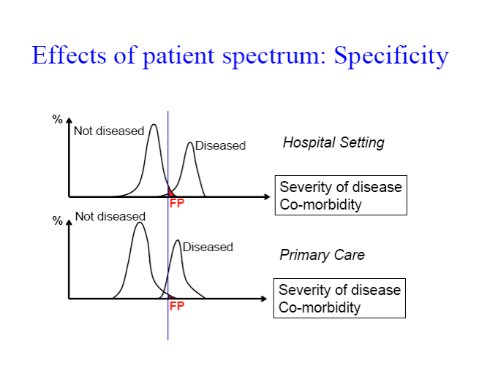
Severity of the disease
co-morbidities
Severity of the disease
co-morbidities
Severity of the disease
co-morbidities

Slide 18

Presence of alternative conditions
Bowel wall thickening for the diagnosis of Crohn’s disease ..
……in setting with high prevalence of :
- intestinal tuberculosis
- ulcerative colitis
others……..
Boweli
Specificity
False positive results

Slide 19
Sensitivity and specificity
Sensitivity and specificity are properties of the diagnostic test, which tell us if the test is valid.
They cannot be used to estimate the probability of disease in an individual patient
They are inversely related and are not separable
SENSITIVITY cannot be estimated without estimating SPECIFICITY
SPECIFICITY cannot be estimate without estimating SENSITIVITY

Slide 20
Thank you very much for your attention !

Slide 21
Mnemonic shortcut
SnOUT & SpiN
54 years old patient presenting at ER for syncope and
dyspnea
Pre-test probability of Pulmonary Embolism = 20%
CT for PE: sensitivity 20% specificity 1%
Test positive ?
Test negative ?
 |  | EP | no EP | tot
TAC | + | 99 | 198 | 297
 | - | 1 | 2 | 3
tot |  | 100 | 200 | 300
LR+ = 0.97/(1-0.03) = 1
LR- = (1-0.97)/0.03 = 1

