Slide 1


QUADAS-2
Mirella Fraquelli
Gastroenterology and Endoscopy Unit
Fondazione IRCCS Ca’ Granda
Ospedale Maggiore Policlinico, Milan
DIAGNOSIS: the pathway of a diagnostic test from bench to bedside.
Basic residential course
4-8 April 2017
Palazzo Feltrinelli - Gargnano, Lake Garda, Italy

Slide 2
Why assessing quality
Bias in primary studies can lead to misleading estimates of accuracy
The studies may not be applicable to the review question
The results of primary studies may vary

Slide 3
Why assessing the quality
Quality assessment is useful to guide the interpretation of results:
In terms of risk of bias and applicability to the review question
To identify potential sources of heterogeneity

Slide 4
Sources of bias and variation
BIAS:
flaws in the design of the study may result in inaccurate estimation of accuracy
APPLICABILITY:
variation across studies means that the results may not be applicable to your review question
QUADAS 2 instrument
Whiting et al. - Ann Intern Med 2011

Slide 5
Structure of QUADAS-2
  Phase 1: State the review question
  Phase 2: Draw a flow diagram for the primary study
  Phase 3: Risk of bias and applicability judgments
      4 key domains:
      patient selection, index test, reference standard, flow & timing
      Each domain rated on risk of bias and concerns regarding applicability
      Signaling questions to help reach rating(s) for each domain

Slide 6
Phase 1: State the review question
Example: Anti-CCP for the diagnosis of RA
Patients: Patients with joint symptoms <12 months duration
Index test(s): Second generation Anti-CCP test analysed by ELISA Rheumatoid factor detected by latex agglutination
Target condition: Rheumatoid Arthritis
Reference Standard: American College of Rheumatology (ACR) criteria
Anti-CCP: anti-cyclic citrullinated peptide antibody
Notes:
At patient think about setting, intended use of index test, presentation, prior testing

Slide 7
Phase 2: Draw a flow diagram
467 consecutive patients
Anti-CCP2: 467
Anti-CCP2
+ve: 95
Anti-CCP2
-ve: 372
RA:
82
Other:
6
Unclear:
7
Unclear 100
Other: 200
RA:
71

Slide 8
Internal vs External validity
Study parameters BIAS (PICO) |  | Clinical question APPLICABILITY (PICO)
Population Index test |  | Population Index test
Reference standard |  | Reference standard
Outcomes |  | Outcomes
Schmidt & Factor - Arch Pathol Lab Med 2013

Slide 9


Diagnostic test accuracy studies
Internal validity
Correct study design
Ideal experimental conditions
Data homogeneity
Reduced heterogeneity
Data precision
and repeatability
External validity
Clinically relevant context
No center selection
No patients selection
Co-morbidity
Data applicability and
transferability

Slide 10
Key Domain | Risk of bias: High/low/unclear | Applicability: High/Low/Unclear
Patient selection | Could the selection of patients have introduced bias? | Are there concerns that the included patients do not match the review question?
Index test | Could the conduct or interpretation of the index test have introduced bias? | Are there concerns that the index test, its conduct, or its interpretation differ from the review question?
Reference standard | Could the RS its conduct, or its interpretation have introduced bias? | Are there concerns that the target condition as defined by the RS does not match the review question?
Flow and timing | Could the patient flow have introduced bias?

Slide 11
DOMAIN 1: Patient selection
A. Risk of Bias
Describe the methods of patient selection:
Was a consecutive or random sample of patients enrolled? Was a case-control design avoided? | Yes / No / Unclear
Did the study avoid inappropriate exclusions? | Yes / No / Unclear
Could the selection of patients have introduced bias? | RISK: LOW / HIGH / UNCLEAR
B. Concerns about applicability
Describe included patients: previous testing, presentation, intended use of index test, and setting
Are there concerns that the included patients do not match the review question? | CONCERN: LOW / HIGH / UNCLEAR
Notes:
avoid inappropriate exclusions ->include “difficult” to diagnose patients?

Slide 12
Patient selection bias
Inappropriate methods of patient selection may introduce bias:
- Study design: patient-control design
- Retrospective enrollment
- Selected enrollment (i.e. non-consecutive or random)

Slide 13
Study design
Basic design of diagnostic accuracy studies:
Prospective, blinded cross classification of test and reference standard in a clinically relevant setting
TP
Liver biopsy
FP
“Relevant” spectrum of patients
TE
FN
Liver biopsy
TN

Slide 14
Spectrum effects: evaluation of 2 very different populations
Diagnostic Patient Control Study
Test
threshold
%
Healthy
volunteers
Very sick
individuals
Test parameter
the healthiest the sickest
SPECTRUM BIAS

Slide 15
Spectrum effects: evaluation of representative populations
Diagnostic Cross-sectional Study
Test
threshold
%
Patients
without disease
Patients
with disease
SPECTRUM VARIATION
Test parameter

Slide 16
Patient selection: applicability
  Measures of accuracy may vary across patient groups:
    Setting
    Advanced vs early disease
    Symptoms
    Demographic features
    Presence of alternative conditions
    Co-morbidities

Slide 17
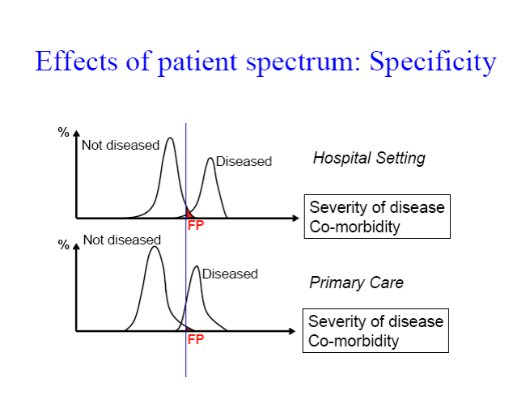
Severity of the disease
co-morbidities
Severity of the disease
co-morbidities
Severity of the disease
co-morbidities

Slide 18
DOMAIN 2: INDEX TEST
A. Risk of Bias
Describe the index test and how it was conducted and interpreted:
Were the index test results interpreted without knowledge of the results of the reference standard? |  | Yes / No / Unclear
If a threshold was used, was it prespecified? |  | Yes / No / Unclear
Could the conduct or interpretation of the index test have introduced bias? | RISK: LOW / HIGH / UNCLEAR
B. Concerns about applicability
Are there concerns that the index test, its conduct, or its interpretation differ from the review question? | CONCERN: LOW / HIGH / UNCLEAR

Slide 19
Index Test bias
Could the conduct or interpretation of the Index Test have introduced bias?
The execution of the Index Test described in sufficient detail to permit replication of results (predefined cut-off etc.)
IT results should be interpreted without knowledge of the RS results (information bias)

Slide 20
Index Test applicability
Are there concerns that the Index Test, its conduct, or interpretation differ from the review question?
If test conduct, technology, setting or interpretation differ from your review question, the results may not be applicable

Slide 21
DOMAIN 3: REFERENCE STANDARD
A. Risk of Bias
Describe the reference standard and how it was conducted and interpreted:
Is the reference standard likely to correctly classify the target condition? |  | Yes / No / Unclear
Were the reference standard results interpreted without knowledge of the results of the index test? |  | Yes / No / Unclear
Could the reference standard, its conduct, or its interpretation have introduced bias? | RISK: LOW / HIGH/ UNCLEAR
B. Concerns about applicability
Are there concerns that the target condition as defined by the reference standard does not match the review question? | CONCERN: LOW / HIGH / UNCLEAR

Slide 22
Reference Standard bias
Could the reference standard, its conduct, or its interpretation have introduced bias?
RS should be the most accurate test to diagnose the TC (misclassification bias)
The execution of the RS should be described in sufficient detail to allow the replication of results (predefined cut-off etc.)
RS should be interpreted blind to IT results (information bias)
IT should not be a part of the RS (incorporation bias)

Slide 23
Misclassification bias
From the GOLD STANDARD
to the REFERENCE STANDARD
The reference standard should accurately reflect
the true state of the patient, but is usually imperfect.
Its sensitivity and specificity are < 100%
Reference standard pos ≠ Target Disease

Slide 24
Misclassification bias
When the reference standard does not correctly classify patients with the target condition
Example
Liver biopsy
as reference standard
For staging hepatic fibrosis
can have
30%
false-negative results
Depends on
Whether both tests
make the
same mistake

Slide 25
Disagreements between Reference Standard and Index Test
REFERENCE STANDARD
Pos Neg
Pos | A agreement | B Cases detected only by the Index Test
Neg | C Cases detected only by the RS | D agreement
Index Test more sensitive
INDEX TEST
Index Test more specific
Glasziou - Ann Intern Med 2008;149:816

Slide 26
Information bias
When the Reference standard is interpreted knowing the Index test results
Example: OLT
US vs CT
in diagnosing hepatic tumours
Tendency to ”over-read” a
suspicious area if other
test results are known
Usually leads to an increase of FP results
Notes:
Although clinical information provided to the interpreter of imaging tests may improve disease detection, it may also bias the interpreter towards certain diagnoses, increasing the chance of false positives.
Clinical data available to the echocardiographer, echocardiogram results, and the final diagnosis.
Four clinical features, when present at the time of echocardiography, were associated with increased numbers of false-positive results. Test specificity was 97% (34/35) for patients without any of these features, but dropped to 80% (16/20) when two or more features were present

Slide 27
Incorporation bias
When the index test is incorporated in a (composite) reference standard
Example
CT scanning of the head to
determine whether children
have cerebrospinal shunt
malfunction
Reference standard:
Clinical assessment by neurosurgeons who used
CT results to decide
Usually leads to
overestimation
of diagnostic test
accuracy

Slide 28
Reference Standard applicability
Outcome of the RS is decisive: If the RS does not detect the target condition defined in the review question results may not be applicable
The choice of valid/optimal RS is crucial
Cholecystitis
HCC and OLT

Slide 29
Flow and timing
A. Risk of Bias
Describe any patients who did not receive the index tests or reference standard or who were excluded from the 2 x 2 table (refer to flow diagram) Describe the interval and any interventions between index tests and the reference standard
Was there an appropriate interval between index test and reference standard? |  | Yes/No/Unclear
Did all patients receive a reference standard? |  | Yes/No/Unclear
Did all patients receive the same reference standard? |  | Yes/No/Unclear
Were all patients included in the analysis? |  | Yes/No/Unclear
Could the patient flow have introduced bias? | RISK: LOW /HIGH/UNCLEAR
Notes:
Delay between tests can cause misclassification due to recovery or progression to more advanced disease
Length of time which may cause such bias will vary between conditions; a minimum period may be required
Any actions taken (e.g. treatment) between the index test and reference standard may bias the results
Example:
Reference standard incorporates follow-up.
A minimum time between tests is required
Treatment cannot affect the presence/absence of RA so should not be problem
The reference standard may be expensive, risky or unpleasant – clinically unwilling to perform on “normals”
If only cases who are test +ve undergo reference standard then we will underestimate the “false negatives” and over-estimate the sensitivity (“work-up/verification bias”)
Alternative methods such as extended follow-up or random sample of test negatives may be appropriate
Example:
All patients should undergo both the anti-CCP test and be evaluated using the ACR criteria
Verification bias unlikely to be a problem as reference standard cheap and non-invasive, but follow-up may be problematic.

Slide 30
Flow and timing bias
Disease progression/regression or Tx paradox bias
Partial or differential verification bias
Response bias

Slide 31
Disease progression/regression or treatment paradox bias
When the patients’ condition changes between administering the index test and the reference standard
Example..
Acute disease
Antiviral Tx of patients with
chronic viral hepatitis while
a non-invasive test for
staging liver fibrosis is
under evaluation
Under- or
Over-estimation
of diagnostic test
accuracy
depending
on changes of patients’
condition

Slide 32
Partial verification bias
When a nonrandom set of patients does not undergo the reference standard
Example
Detection of focal liver
lesions
-
Ultrasound
+ biopsy
Usually leads to
overestimation
of sensitivity;
effects on specificity
varies

Slide 33
Differential verification bias
When a set of patients is verified with a second or third reference standard, especially when this selection depends on the index test result
Example
Detection of focal liver lesions
- TC / RMN
US
+ biopsy
Usually leads to
overestimation
of diagnostic test
accuracy

Slide 34
Response bias
When uninterpretable or intermediate test results and withdrawals are not included in the analysis
Example..
Technical faults or inferior image quality
Any non-random missing data for study patients
(e.g. disease-free cases that were not thoroughly investigated)
Usually leads to
overestimation
of diagnostic test
accuracy
Notes:
Patient preferences of satyisfactory studies

Slide 35
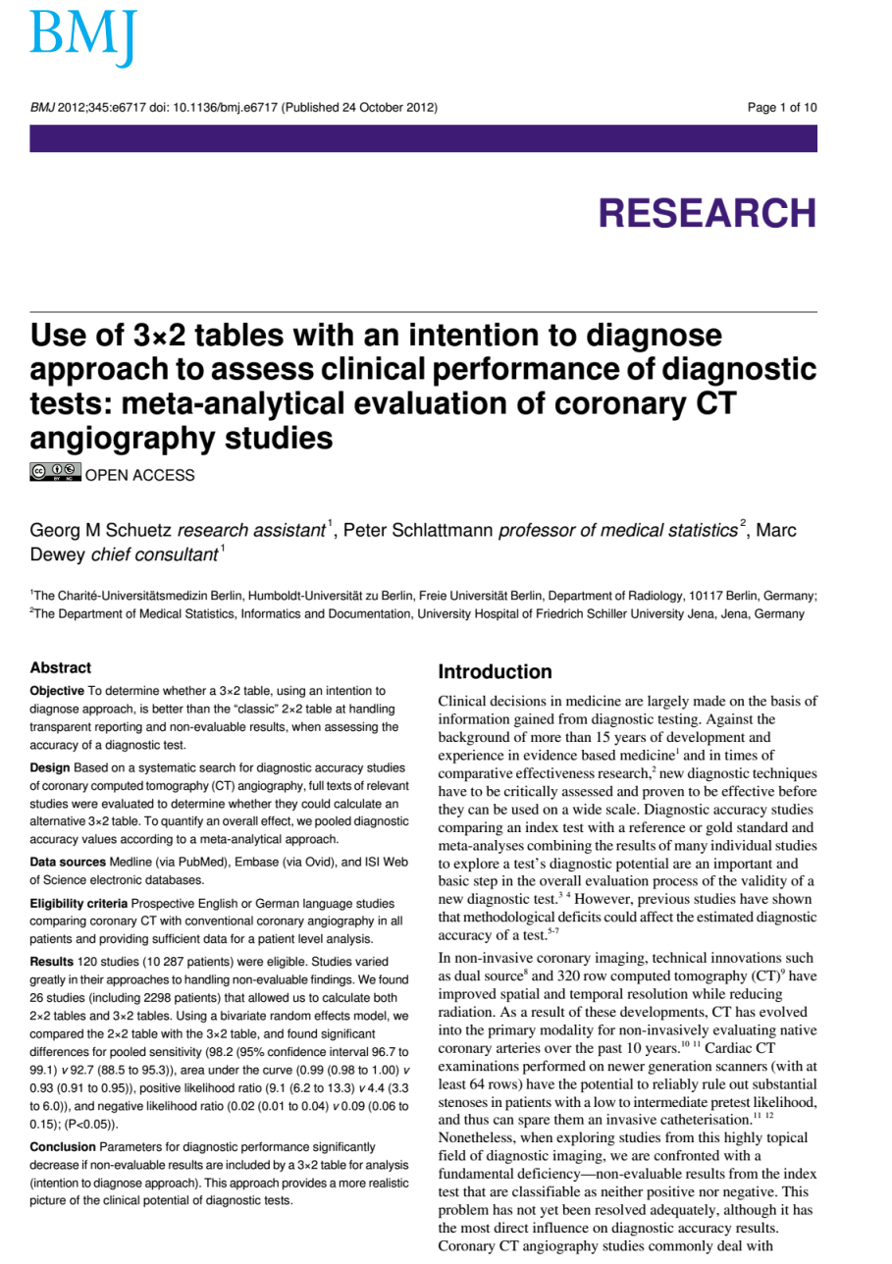
Indeterminate results
Patients excluded from the analysis
Indeterminate/unclassified
Index test results
intention-to-diagnose
approach

Slide 36
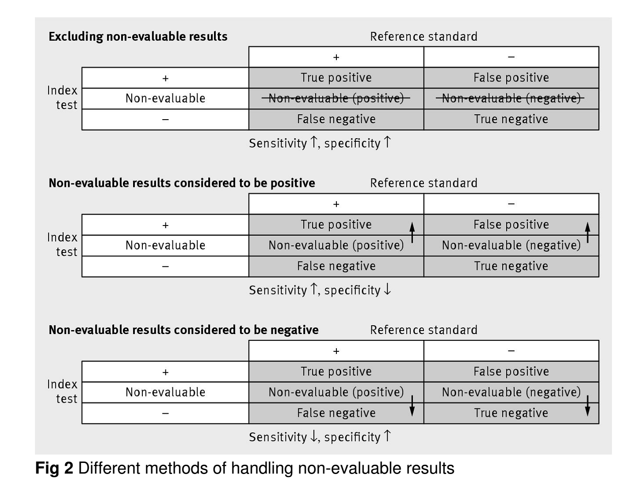
Indeterminate results
Different scenarios

Slide 37
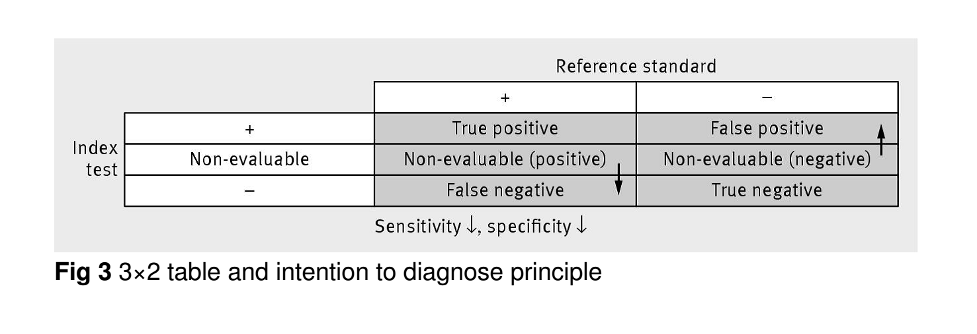
Indeterminate results
Intention-to-diagnose
Indeterminate results
considered either as False-positive or False-negative

Slide 38
Indeterminate results
REFERENCE STANDARD
Pos Neg
+ | TP | FP
Indeterminate | X | Y
_ | FN | TN
INDEX TEST
Intention-to-diagnose

Slide 39
Indeterminate results
1st scenario
The indeterminate results are not analyzed
 |  | CT
 |  | + | - | tot
Rx | + | 10 | 2 | 12
 | uncertain | 10 | 5 | 15
 | - | 11 | 20 | 31
 | tot | 31 | 27 | 58
 |  | CT
 |  | + | - | tot
Rx | + | 10 | 2 | 12
 | - | 11 | 20 | 31
 | tot | 21 | 22 | 43
Sensitivity: | 0.476
Specificity: | 0.909

Slide 40
Indeterminate results
2nd scenario
The indeterminate results are divided half to Rx + and half to Rx -
 |  | CT
 |  | + | - | tot
Rx | + | 15 | 4 | 19
 | - | 16 | 23 | 39
 | tot | 31 | 27 | 58
 |  | CT
 |  | + | - | tot
Rx | + | 10 | 2 | 12
 | uncertain | 10 | 5 | 15
 | - | 11 | 20 | 31
 | tot | 31 | 27 | 58
Sensitivity: | 0.483
Specificity: | 0.852

Slide 41
Indeterminate results
3rd scenario
The indeterminate results are classified as FN and FP
 |  | CT
 |  | + | - | tot
Rx | + | 10 | 7 | 17
 | - | 21 | 20 | 46
 | tot | 31 | 27 | 58
 |  | CT
 |  | + | - | tot
Rx | + | 10 | 2 | 12
 | uncertain | 10 | 5 | 15
 | - | 11 | 20 | 31
 | tot | 31 | 27 | 58
Sensitivity: | 0.323
Specificity: | 0.741

Slide 42
Indeterminate results
4rd scenario
The indeterminate results are classified as:
 |  | CT
 |  | + | - | tot
Rx | + | 10 | 2 | 12
 | uncertain | 10 | 5 | 15
 | - | 11 | 20 | 31
 | tot | 31 | 27 | 58
Positive
TP e FP
Negative
TN e FN
 |  | CT
 |  | + | - | tot
Rx | + | 20 | 7 | 27
 | - | 11 | 20 | 31
 | tot | 31 | 27 | 58
 |  | CT
 |  | + | - | tot
Rx | + | 10 | 2 | 12
 | - | 21 | 25 | 46
 | tot | 31 | 27 | 58
Sensitivity: | 0.645
Specificity: | 0.741
Sensitivity: | 0.323
Specificity: | 0.926

Slide 43
Indeterminate results
To eliminate results
High risk of bias approach
Sensitivity: 0.476
Specificity: 0.909
Indeterminate: Rx- (TN e FN)
Indeterminate: Rx+
(TP e FP)
Indeterminate
Divided + e -
Sensitivity: 0.323
Specificity: 0.926
Sensitivity: 0.645
Specificity: 0.741
Sensitivity: 0.483
Specificity: 0.852
More conservative approach
Indeterminate: FP e FN
Sensitivity: 0.323
Specificity: 0.741

